Slide 1

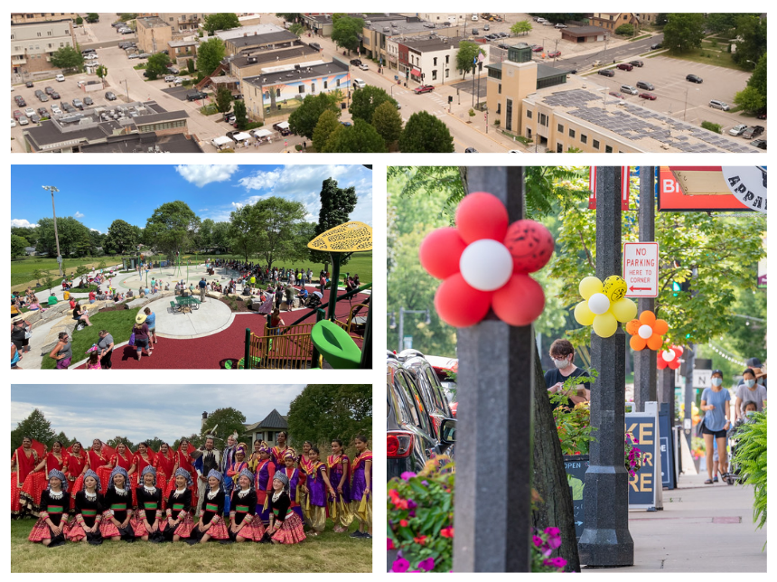
2022
STRATEGIC
PLAN
UPDATE
October 4, 2022

Slide 2
Housing and Neighborhoods
Sun Prairie is a place of vibrant and robust neighborhoods made up of housing with options for all with options at all price ranges for those that desire to rent or own.
Dynamic Economy
Sun Prairie is the home of many cutting-edge businesses applying innovative practices and technology to bring new and exciting products to the market every day. These businesses employ many highly skilled, highly paid Sun Prairie residents.
Downtown and Central Corridor Vibrancy
Our Downtown and Central Corridor is a bustling place with entertainment, dining, housing, and cultural opportunities. This area has restaurants, breweries, and music venues that host active entertainment day and night. Downtown is easy to get to by bike, car, foot, bus, ride-sharing, taxi, or train.
Complete Transportation Network
The community has multiple modes of transportation, ensuring the entire population has options for safe and efficient travel. The City has multiple alternatives for travel including pedestrian walkways, biking lanes, and mass transit.
Notes:
Overview of the eight focus areas
Housing and Neighborhoods ensures that Sun Prairie is a community that everyone can call home and feel like they belong.
The next focus area highlights our downtown area and promotes social, cultural and recreational opportunities for all its residents.
Our diverse business community is home to innovation and new technologies. It is also where local and small businesses and entrepreneurs can thrive in.
A complete transportation network supports multiple modes of transportation for its residents through exploring and investing in our infrastructure and mass transit options.

Slide 3
Human Services
The community offers a wide range of human services to assist residents to live to their full potential.
Quality City Services
City services are efficient, friendly, and competent. In addition to maintaining roads, water, sanitary sewer, storm sewer, electric infrastructure, sidewalks, bike paths, we anticipate future needs.
Sustainable Sun Prairie
Sustainability is a community aspiration. It includes City government, which demonstrates leadership in sustainable practices through promotion, education, and incentives to move our community toward locally produced solar, wind, and geothermal energy.
Employer of Choice
In Sun Prairie, our City employees are essential to our success. We have excellent public services which can only be provided by dedicated and talented staff. City leadership is committed to providing an excellent salary and benefit package.
Notes:
Sun Prairie is a hub for various service providers and service organizations to help our residents live healthy and happy lives.
Sustainable Sun Prairie is the city’s commitment to reducing its carbon footprint and investing in renewable energy. Investments in sustainable land use development, the local economy and engagement with residents will help get us there.
To meet the needs of a growing and changing community, quality city services allow the city to anticipate future needs and ensure city services are efficient, friendly and competent.
Lastly, city services are provided by talented and dedicated employees who work together toward common goals.

Slide 4
Summary of Progress
10 priorities completed
11 ongoing priorities
14 in progress priorities
1 priority not started
Notes:
97% of initiatives identified are completed, ongoing or in progress.
2020 numbers for comparison:
Summary of Progress
5 initiatives completed
13 ongoing initiatives
5 in progress initiatives
11 initiatives not started

Slide 5
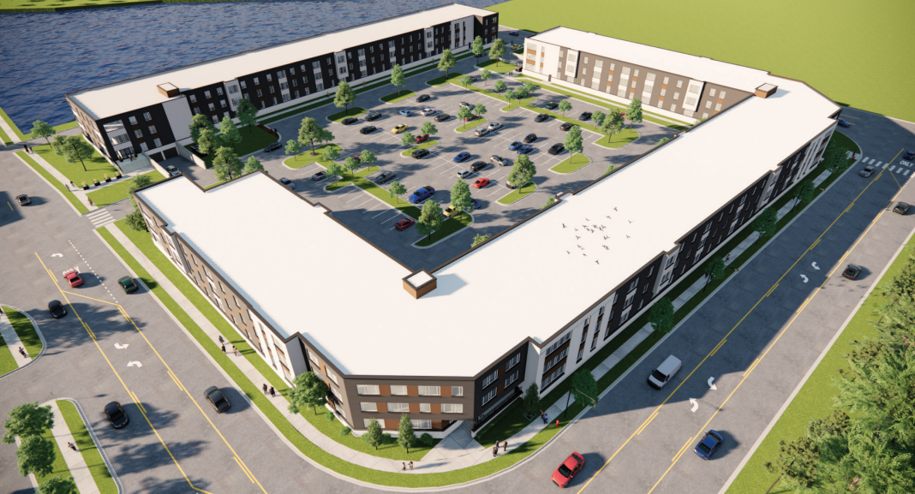
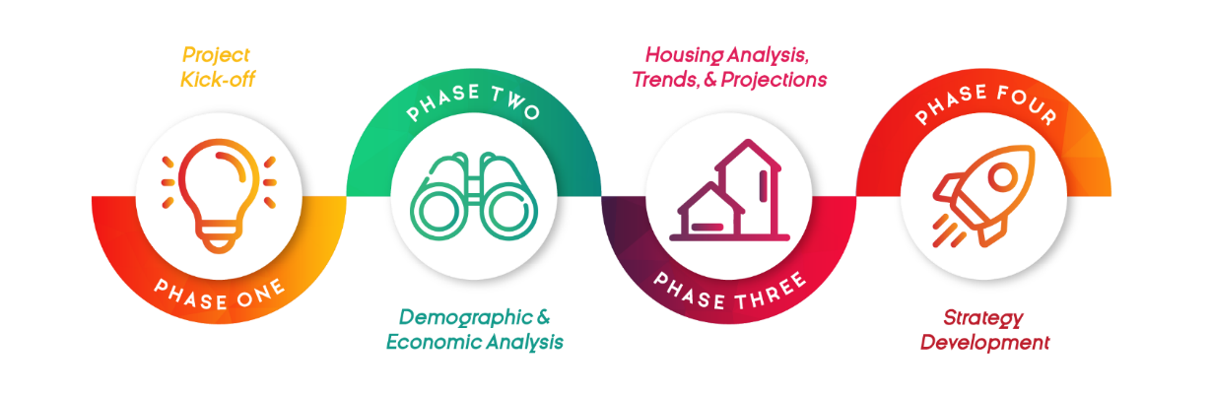
Housing and Neighborhoods
ARPA funding, in combination with Planning Department Professional Services funds, have been allocated to complete a comprehensive update of the Zoning Ordinance. This project will likely begin in early 2023
The housing study has been completed and the report accepted by Council
Housing Committee ordinance adopted
Housing and Equitable Development Planner hired – start date of October 3
Several housing projects in development
Sunshine Place Housing Navigation Services – ARPA funding
Notes:
Housing and Neighborhoods ensures that Sun Prairie is a community that everyone can call home and feel connected with housing options for all.
Habitat for Humanity at Town Hall Crossing - 118 single-family homes with 40% of them for Habitat homeowners
Roers Development – 172 multi family affordable housing units
The Landing at 818 – 100 affordable housing units for seniors
CR Dev Co, Hey Day Development, single family and multifamily development on North Bird

Slide 6
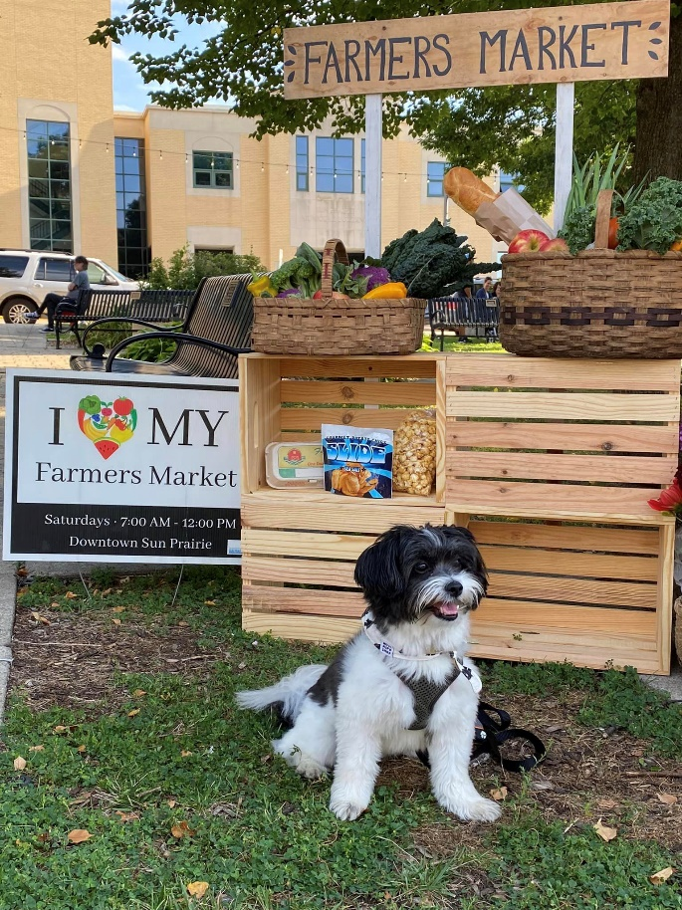

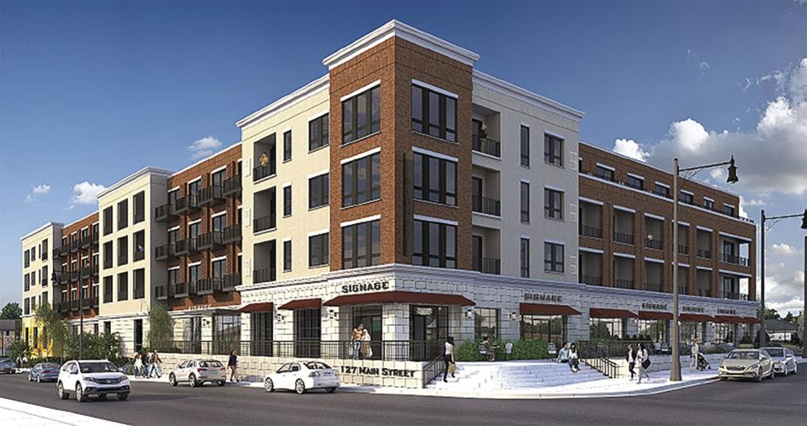
Downtown and Central Corridor Vibrancy
Lokre Development – 92 dwelling units and approximately 12,000 sf of commercial/office space
Sun Prairie Utilities in the design process for their new facility located at 510 Linnerud Drive
Sun Prairie Utilities working with interested developer for re-use of
its current site
Fire and Lights Parade returned to the downtown
Increased programming and events with Saturday Farmer’s Market
BID 5-Year Strategic Plan
Notes:
The next focus area highlights our downtown area and promotes social, cultural and recreational opportunities for all its residents.
Redevelopment at Main/Bristol
Lokre Development – 92 multi family market rate units
It’s the first in-person fire and lights parade since the COVID-19 pandemic began. The 2020 event was held as a drive thru parade at Angell Park and virtual tree lighting.
BID 5-year plan
Branding/Placemaking
Operations/Programming
Transportation/Accessibility
Future Development

Slide 7
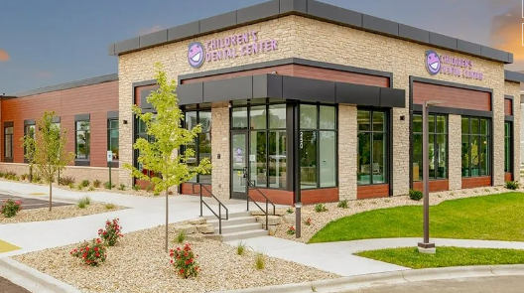
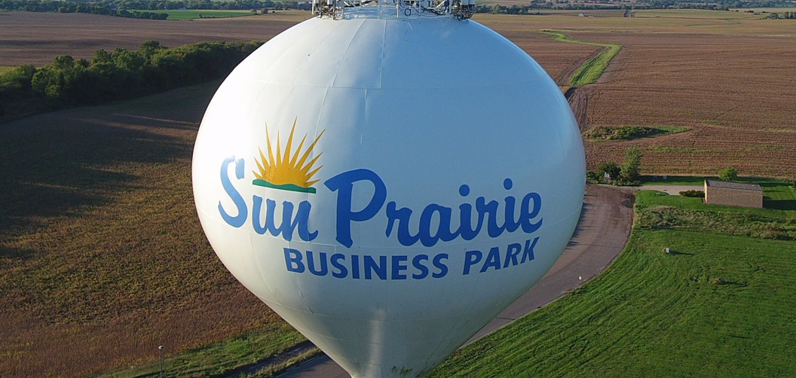
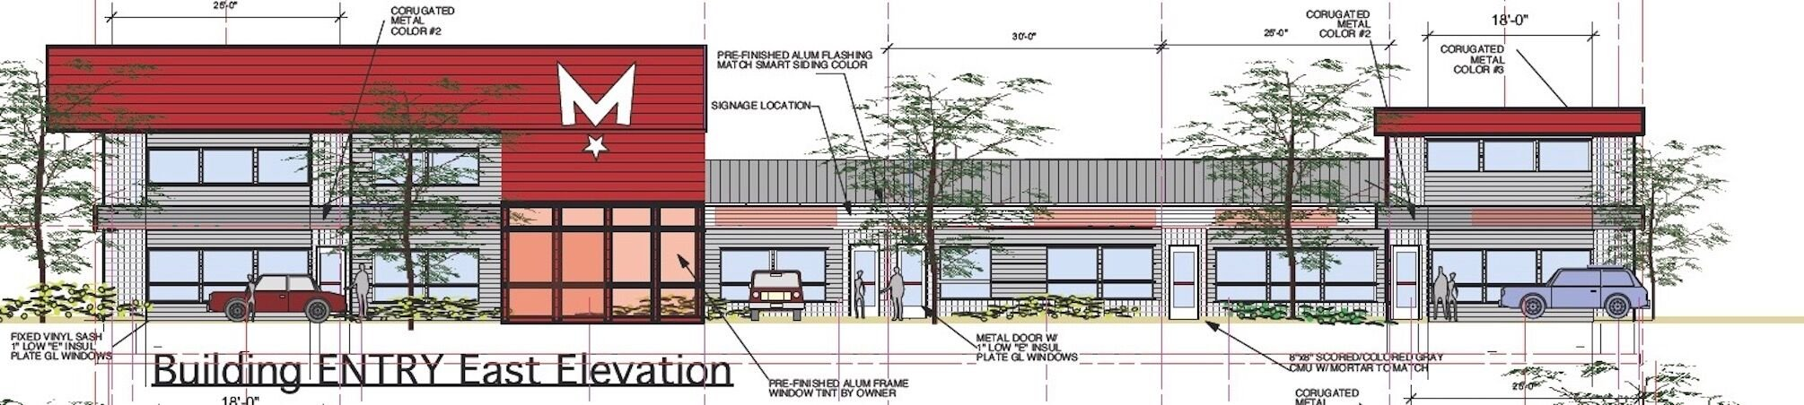
Dynamic Economy
An update to the Economic Development element of the Comprehensive Plan is planned to begin this fall to strategize on what businesses we want to attract to Sun Prairie
Approaching mid-point of the Branding Study. Additionally, $50,000 in ARPA funding was allocated by the Council to support the brand implementation following the completion of the study
The City has entered into a contract with Oakbrook Corp to market the City-owned TID 12 lands to private developers
Sun Prairie continues to attract new developments and businesses
Notes:
Our diverse business community is home to innovation and new technologies. It is also where local and small businesses and entrepreneurs can thrive in.
New businesses:
Second Culvers (Ironwood)
Diventures Swim School (Pumpkin Patch)
Valvoline Oil (Pumpkin Patch)
Indoor Self Storage (West Prairie Village-across the street from Pumpkin Patch)
Golden Nest Pancake and Swagat (Prairie Lakes)
Developments:
Trachte & MKE Tool expansions (Park 151)
Madison Graphics (expansion and new location)

Slide 8
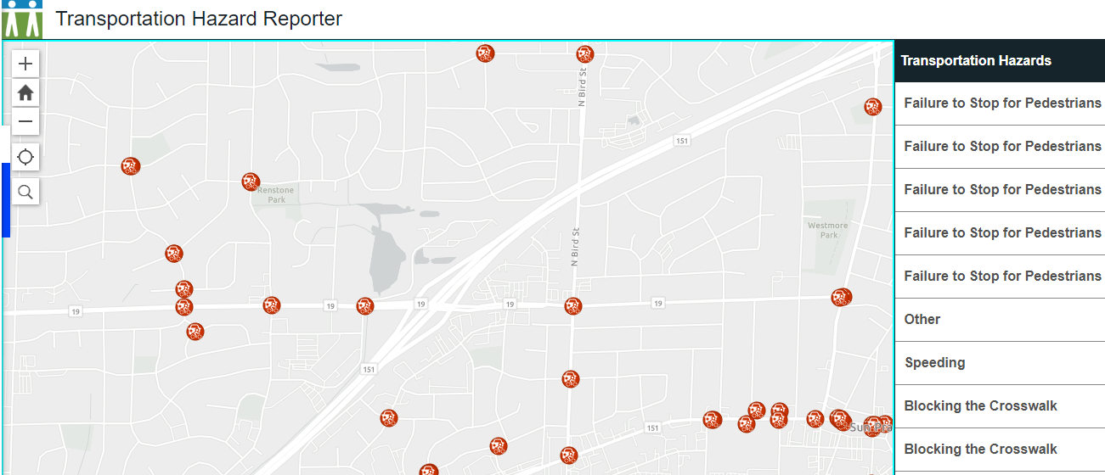
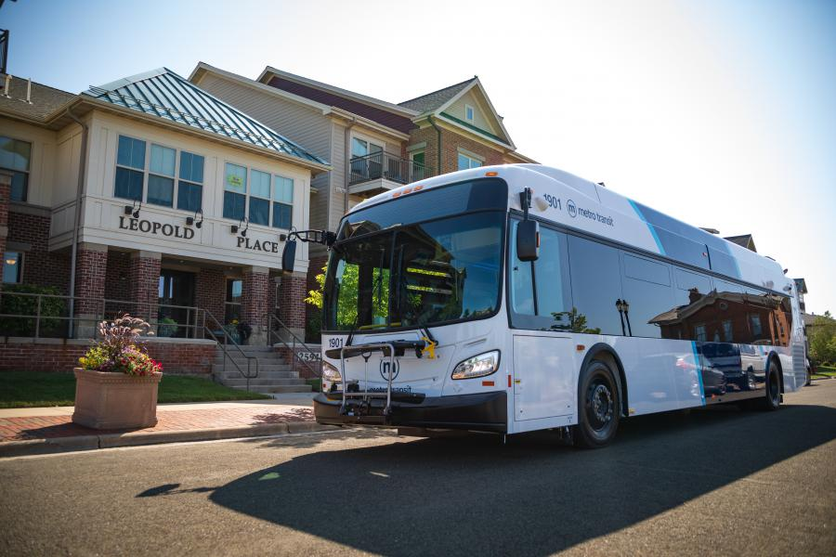
Complete Transportation Network
Madison Metro has committed to providing local bus service - all day, 7-days a week service in addition to the BRT connection as soon as August 2023. Transit Commission has approved and signed off on the local route
Toole Design Group has been contracted to work with the city to complete the Active Transportation Plan. The steering committee just had its first kick-off meeting. Staff expect to have that plan completed by the end of Summer/beginning of Fall 2023
Received $72,000 in federal funds to implement a Sun Prairie Vision Zero Action Plan by WisDOT
Received $650,000 from WisDOT Highway Safety Improvement Program for O’Keeffe Avenue & McCoy Road/Sunfield Street reconfiguration
Notes:
A complete transportation network supports multiple modes of transportation for its residents through exploring and investing in our infrastructure and mass transit options.
$100,000 annually in CIP for Pedestrian Safety Projects
2023 CIP – addition of an electric bus charger and all-weather restroom facility at the existing park and ride.
The total cost of the projects is $722,833 with $650,500 coming from the HSIP program for vehicle and pedestrian improvements at the intersection Construction is anticipated to occur in 2025.

Slide 9
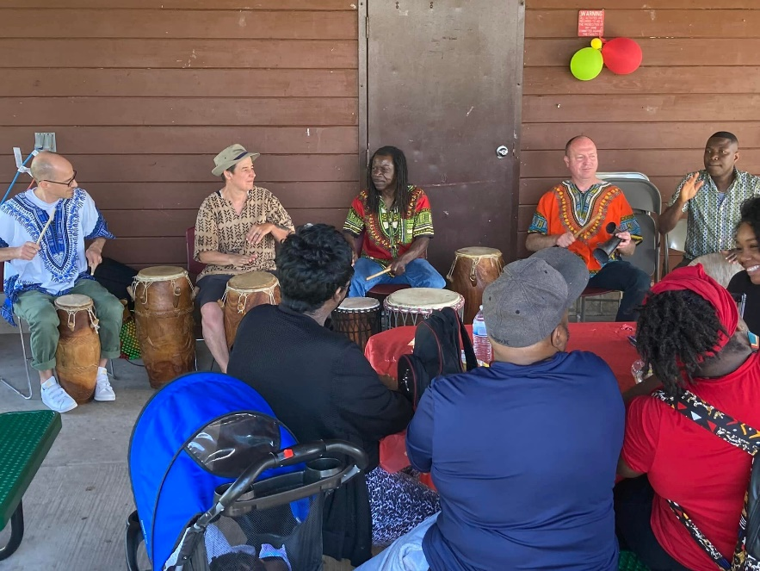
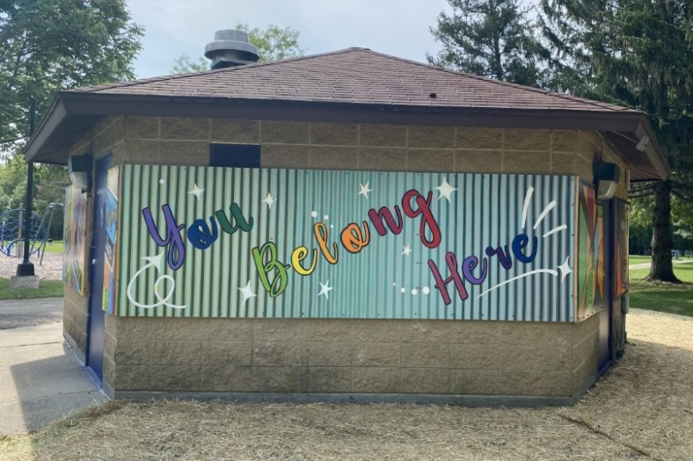
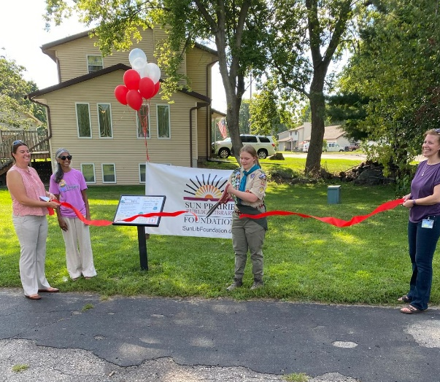
Human Services
The library is currently working with ReThinking Libraries (RtL) on a new three-year strategic plan (2023-2025)
Awarded $1.1 million in grants to local organizations (ARPA)
Dream Up Grant: Child Care Supply-Building Program
Neighborhood Navigator Program Expansion
COVID Clinics at the Sun Prairie Public Library
Mental health programming in partnership with NAMI Dane County
Inclusion in the Parks Mural and permanent story walk at Sheehan Park
Community engagement opportunities and partnerships
Notes:
Sun Prairie is a hub for various service providers and service organizations to help our residents live healthy and happy lives.
Dream UP: Received $75,000 grant from Wisconsin DCF for the Dream Up! This grant is focused on childcare supply-building and provides recipients with professional consulting services to develop a strategic childcare supply-building plan. By implementing a strategic childcare supply-building plan ,the City and a core group of 19 individuals, representing 13 different organizations who are involved with this grant work are able to having ample funding to begin plan implementation and draw in other funders to be part of the solution.
Thriving Sun Prairie Program – Neighborhood Navigator Program Manager and Community Health Worker
Received award of DHS 2109 COVID response grant which allowed the addition of a Neighborhood Navigator Program Manager position
Received ARPA funding to create a Community Health Worker position
Neighborhood Navigators participated in weekly community engagement stops at Rolling Prairie, Element, and Vandenburg Heights Park (1x/week during the school year and 2x/week in the summer)
Navigators expanded the summer youth mentorship program and provided resilience-building and mentorship experiences for approximately 80 unduplicated youth
Mental Health Awareness Month – Mental Illness 101 to develop general understanding and awareness at the library
Building community through engagement and partnerships:
Juneteenth
Multicultural Fair
BEAM Awards
Police Chief Advisory Board and Library DEI Board
Branding Plan
Partnered with school district to begin Thursday Afterschool Program in response to the change in bell times. The program is currently at 3 SPASD schools and will expand to more as the school year continues and we are able to hire staff.

Slide 10
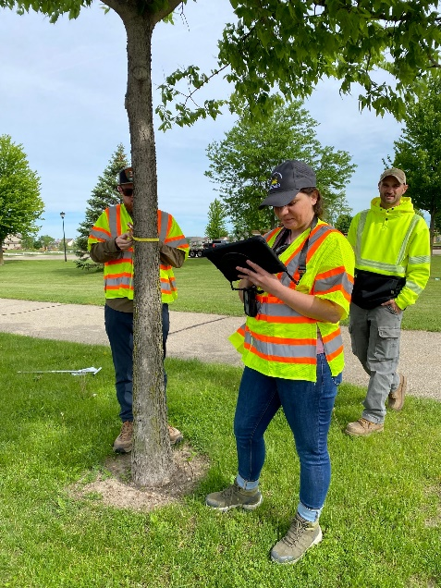

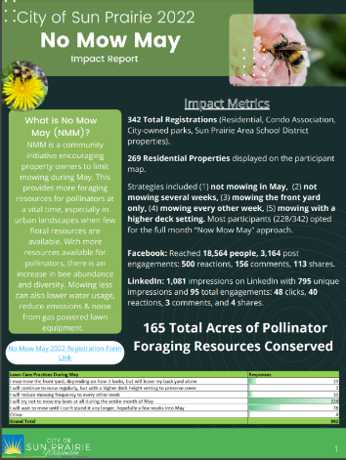
Sustainable Sun Prairie
Achieved 2021 Climate Champion status in the “Other” category with a Level 2 distinction due to its significant investments and commitment to climate action
Several grants received and projects implemented or in the works to support sustainable City operations
ARPA funding, in combination with Planning Department Professional Services funds, have been allocated to complete a comprehensive update of the Zoning Ordinance to include the land use chapter. This project will likely begin in early 2023
Expanded pollinator garden at Vandenburg Heights Park & added demonstration pollinator garden in parking islands of Westside Community Services Building parking lot
Electric Prairie Podcast in partnership with the Media Center
No Mow May and Compost Bin Group Purchase Program
Completed a city-wide tree inventory
Notes:
Sustainable Sun Prairie is the city’s commitment to reducing its carbon footprint and investing in renewable energy. Investments in sustainable land use development, the local economy and engagement with residents will help get us there.
City recently completed its PSC grant to conduct a Library community resiliency center feasibility study (Solar PV + Battery Storage for critical loads) in conjunction with the expansion.
City received 2 additional OEI grants this year to support operations at city hall and WWTP. (total $190,000 in grant funding)
Partnership with students at Patrick Marsh to hold a composting 101 course at the library
City staff are working on finalizing the contract for the LED replacement project at city hall which will support this priority.
Received $25,000 Urban Forestry Grant to support the completion of a city-wide tree inventory (here you have Brandon, Demetra and Karl)

Slide 11
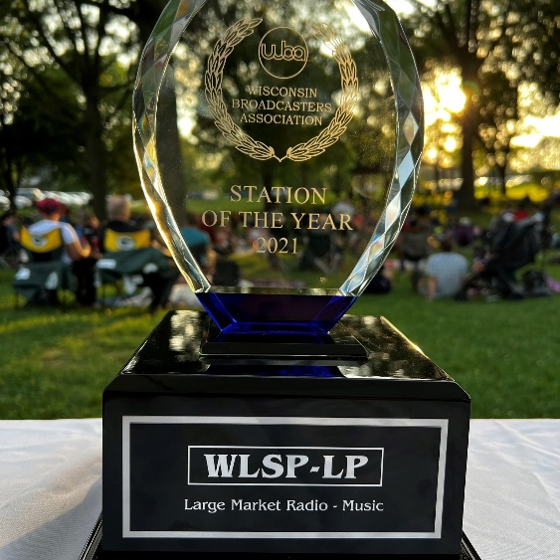
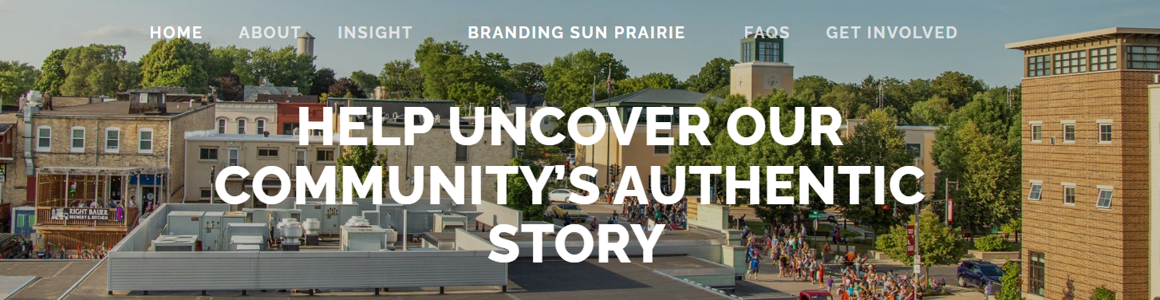
Quality City Services
Third EMS/Fire station facilities study in partnership with Five Bugles and GIS
Marshall EMS Expansion
Parks improvements
EMS DHS Flex Grant Received - $141,490 for replacement of cardiac monitors
Sun Prairie Utilities Communications Coordinator position
Several new positions hired
  New Coordinated Response Specialist position in the Sun Prairie Police Department
Several Strategic Plans in the works
Award recognitions
  Wisconsin Parks and Recreation Awards
  GFOA Awards of Excellence
  Best of the Midwest Media Fest
  Wisconsin Broadcasters Association Awards
Notes:
To meet the needs of a growing and changing community, quality city services allow the city to anticipate future needs and ensure city services are efficient, friendly and competent.
Chief Garrison is working with Five Bugles to review data of EMS/Fire calls to make data driven decisions on where to strategically plan for a future location. The Marshall EMS expansion and potential expansion with other communities will be anticipated as a part of this study.
Added 49 universal access picnic tables to our park inventory
Approved the pilot program to allow dogs in parks
Hosted 11 concerts at Wetmore Park – grew the event significantly by adding beer and food vendors
Removed barriers from Park & Rec Scholarship program by making it a quick an easy, “no questions asked” online form. More than doubled its usage from 2021.
2022 positions hired – IT Systems Administrator, Police Officer, Paramedic,
Strategic Planning – BID 5-year strategic plan, library strategic plan, media center strategic plan, equity audit
Award recognitions
WPRA
Park design (2) for Sunset Park and Vandenburg Heights Park
Silver Star Award for Creative Service Delivery/Marketing for FUN Prairie
GFOA
City’s Annual Comprehensive Financial Report (ACFR) and the Popular Annual Financial Report (PAFR) for 2020 received the Government Finance Officers Associations (GFOA) Awards of Excellence.
Also received GFOA Budget Award for 2022 Approved Budget
The City has been a “Triple Crown Winner” since 2018 when the Finance department started submitted the City’s annual budget for the Distinguished Budget Presentation Award.
Best of the Midwest Media Fest (18 awards for 18 shows on KSUN or 103.5)
Wisconsin Broadcasters Association Award
Four awards: Best Radio Show, Best Newscast, Best Significant Community Impact and Station of the Year for Large Market (Music Category)

Slide 12

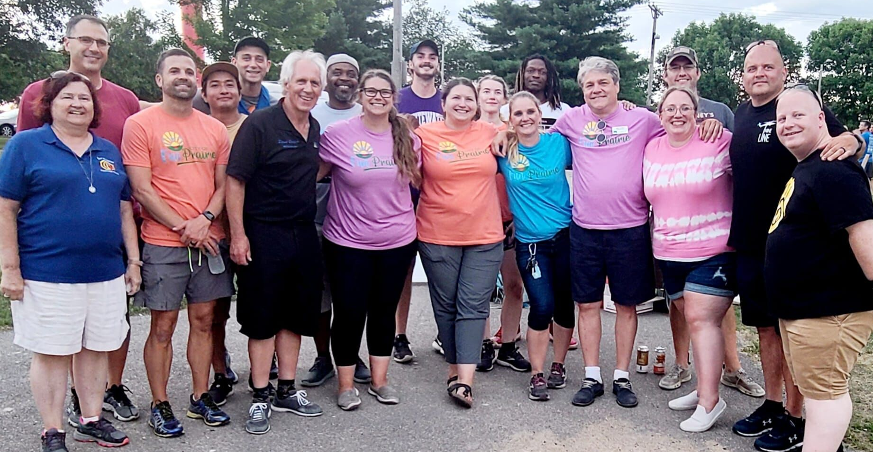
Employer of Choice
Employee Wellness Clinic is moving to Central Heights Middle School
  Expansion of services
Health Insurance Strategic Plan for the next five years
Ongoing evaluation and adoption of workplace policies and family supportive policies
Increased wages for FAC staff and Navigators
Nonunion Class and Compensation Study
Equity Audit
Notes:
Lastly, city services are provided by talented and dedicated employees who work together toward common goals.
Expansion of Employee Wellness Clinic to include behavioral health – Behavioral and Mental Health Wellness Coach to address barriers to accessing someone and reduce wait times to being seen.
Updated paid parental leave policy, telecommuting policy, updated vacation schedule
Increased wages
o Increased Navigator rate of pay from $12.85/hour to $18.00/hour
o Increased FAC staff pay by $2.00/hour
Class and Compensation Study
study of 125 non‐represented positions, and development of competitive pay plan(s) to attract and retain a diverse pool of highly qualified individuals for the present and future years.
City’s organizational equity audit:
Build a more diverse and inclusive organization for employees and the community in which we serve.
Identify blind spots and processes that perpetuate systemic injustice.
Identify current successes, areas for improvement and recommendations/strategy for our next steps for making concrete improvements in the areas of diversity, equity and inclusion.

Slide 13
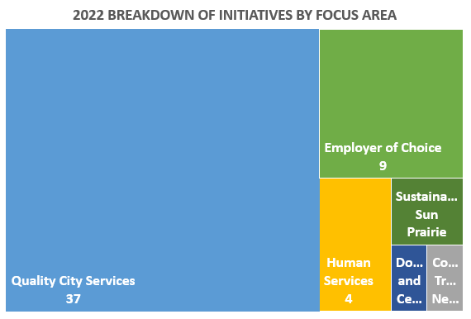
Building on the Strategic Plan
Operational Impact
2023-2032 CIP
2023 Budget
Financial Management Plan
ARPA Internal Requests
Notes:
The Strategic Plan is used to guide department operations, programs and service delivery
Budget initiatives and Capital Projects that are proposed must include a component that identifies the focus area it supports. There is alignment between the Council’s vision and the work staff is doing.
Added to the strategic plan every year in response to needs – new strategies, programs, activities
54 funded initiatives approved in 2022 budget valued at $2,137,240
There is alignment between the Council’s vision and the work staff is doing.
$2,389,814 proposed and $2,137,240 funded

Slide 14
Building on the Strategic Plan
Operational Impact
2023-2032 CIP
2023 Budget
Financial Management Plan
ARPA Internal Requests
COVID-19 impacts
Revenue shortfalls, supply chain shortages, and rising expenditures will bring budget challenges
Increased need for services for residents
American Rescue Plan Act: investing in our community
Notes:
May result in many departmental projects and actions to be accelerated or delayed.
Result in more prioritization and innovation by the City.
ARPA – support public health response, address negative economic impacts caused by public health emergency, provide premium pay, necessary investments in water, sewer, broadband

Slide 15
Building on the Strategic Plan
Operational Impact
2023-2032 CIP
2023 Budget
Financial Management Plan
ARPA Internal Requests
COVID-19 impacts
Revenue shortfalls, supply chain shortages, and rising expenditures will bring budget challenges
Increased need for services for residents
American Rescue Plan Act: investing in our community
What’s next?
Strategic Plans are living documents
Continued alignment Budget and CIP process to the Strategic Plan
18-month extension of current Strategic Plan
  Opportunity to review and revisit for alignment
  Council strategic plan work session in 2024
Notes:
Acknowledge that despite these challenges, we’ve continued to make significant progress in our values, as identified in the 2035 Vision
As we move forward, we’ll continue to identify actions that departments have taken to meet these goals
Are these still our priority areas? Mission to staff is to look ahead to trends, challenges, where to grow/improve,
Ideas to endorse/prioritize for staff

Slide 16
Thank you!

