Slide 1
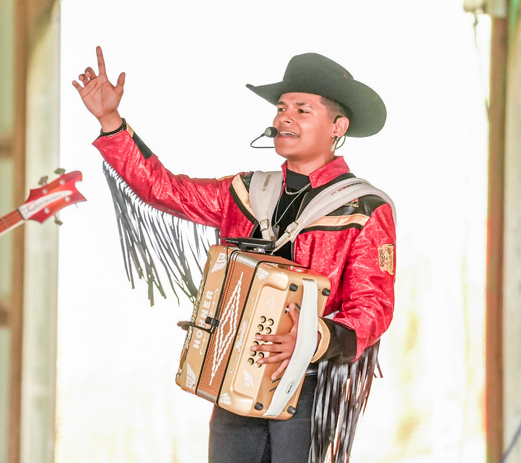
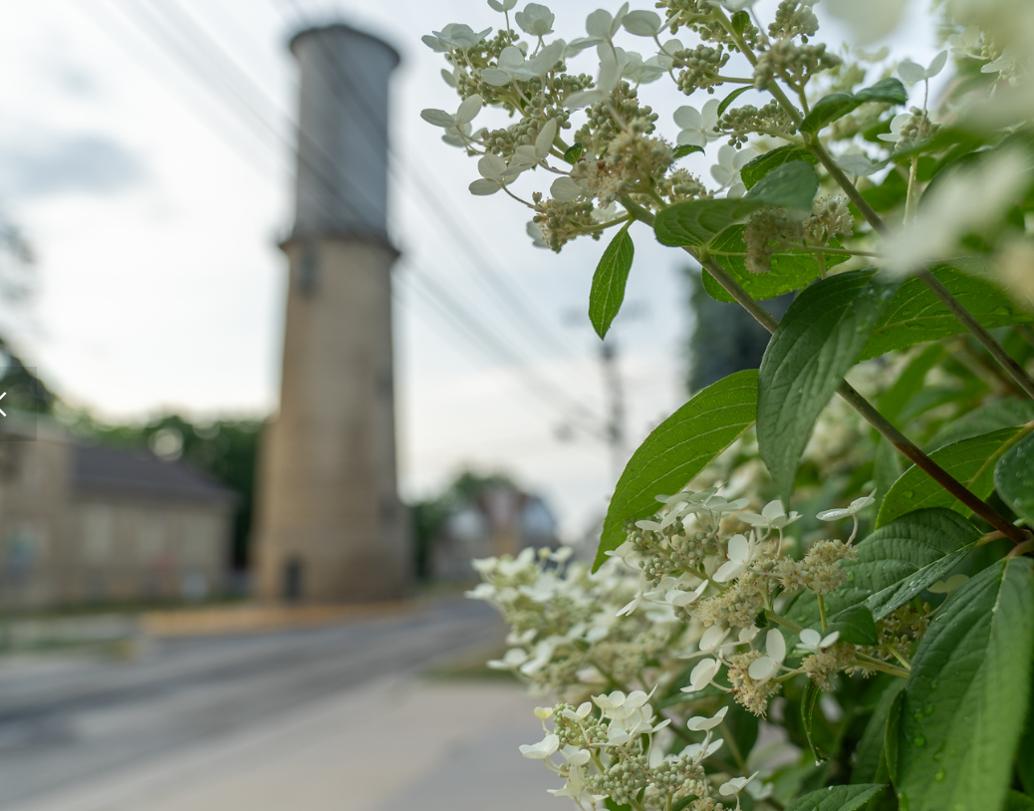



2023 Strategic Plan Update
October 10, 2023
Photo Credit: Focal Flame Photography

Slide 2
Focus Areas
Housing and Neighborhoods
Sun Prairie is a place of vibrant and robust neighborhoods made up of housing with options for all with options at all price ranges for those that desire to rent or own.
Dynamic Economy
Sun Prairie is the home of many cutting-edge businesses applying innovative practices and technology to bring new and exciting products to the market every day. These businesses employ many highly skilled, highly paid Sun Prairie residents.
Downtown and Central Corridor Vibrancy
Our Downtown and Central Corridor is a bustling place with entertainment, dining, housing, and cultural opportunities. This area has restaurants, breweries, and music venues that host active entertainment day and night. Downtown is easy to get to by bike, car, foot, bus, ride-sharing, taxi, or train.
Complete Transportation Network
The community has multiple modes of transportation, ensuring the entire population has options for safe and efficient travel. The City has multiple alternatives for travel including pedestrian walkways, biking lanes, and mass transit.

Slide 3
Focus Areas
Human Services
The community offers a wide range of human services to assist residents to live to their full potential.
Quality City Services
City services are efficient, friendly, and competent. In addition to maintaining roads, water, sanitary sewer, storm sewer, electric infrastructure, sidewalks, bike paths, we anticipate future needs.
Sustainable Sun Prairie
Sustainability is a community aspiration. It includes City government, which demonstrates leadership in sustainable practices through promotion, education, and incentives to move our community toward locally produced solar, wind, and geothermal energy.
Employer of Choice
In Sun Prairie, our City employees are essential to our success. We have excellent public services which can only be provided by dedicated and talented staff. City leadership is committed to providing an excellent salary and benefit package.

Slide 4
Summary of Progress

Slide 5
Summary of Progress
14 priorities completed
5 ongoing priorities
16 in progress priorities
1 priority not started

Slide 6
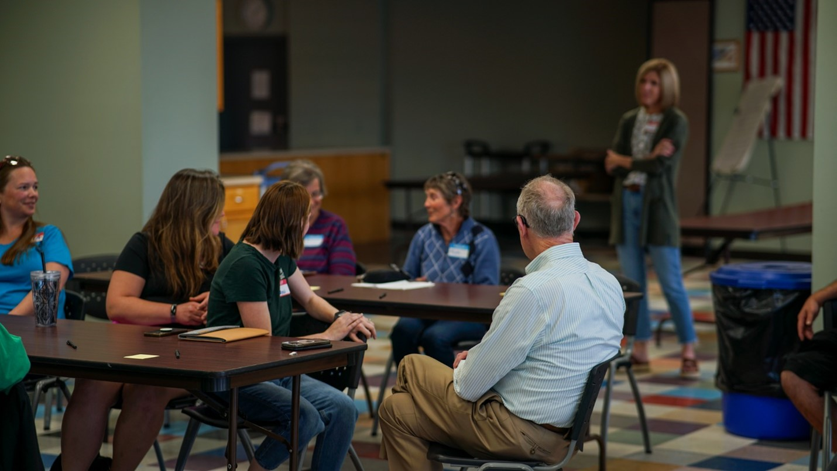
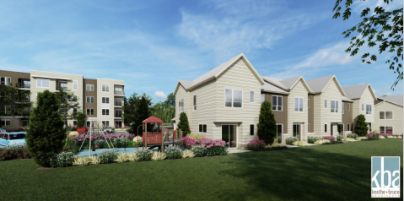
Housing and Neighborhoods
A consultant has been selected to work on the city’s Zoning Code Project which is anticipated to start in November.
Staff and the Housing Committee working closely to create a comprehensive housing program.
Sun Prairie Housing Coalition kicked off with about 30 community members in attendance
Several housing projects in development
Notes:
Housing and Neighborhoods ensures that Sun Prairie is a community that everyone can call home and feel connected with housing options for all.
Habitat for Humanity at Town Hall Crossing - 118 single-family homes with 40% of them for Habitat homeowners
Roers Development – 172 multi family affordable housing units
Held grand opening for Landing at 818 – 100 affordable housing units for seniors
Northpointe Development – 75 units of housing (61-unit multifamily senior living and 14 town home units with passive recreational and commercial space.
Sun Prairie Housing Coalition is having fruitful discussions about their goals of focusing on local education and advocacy efforts to improve housing conditions in Sun Prairie.

Slide 7

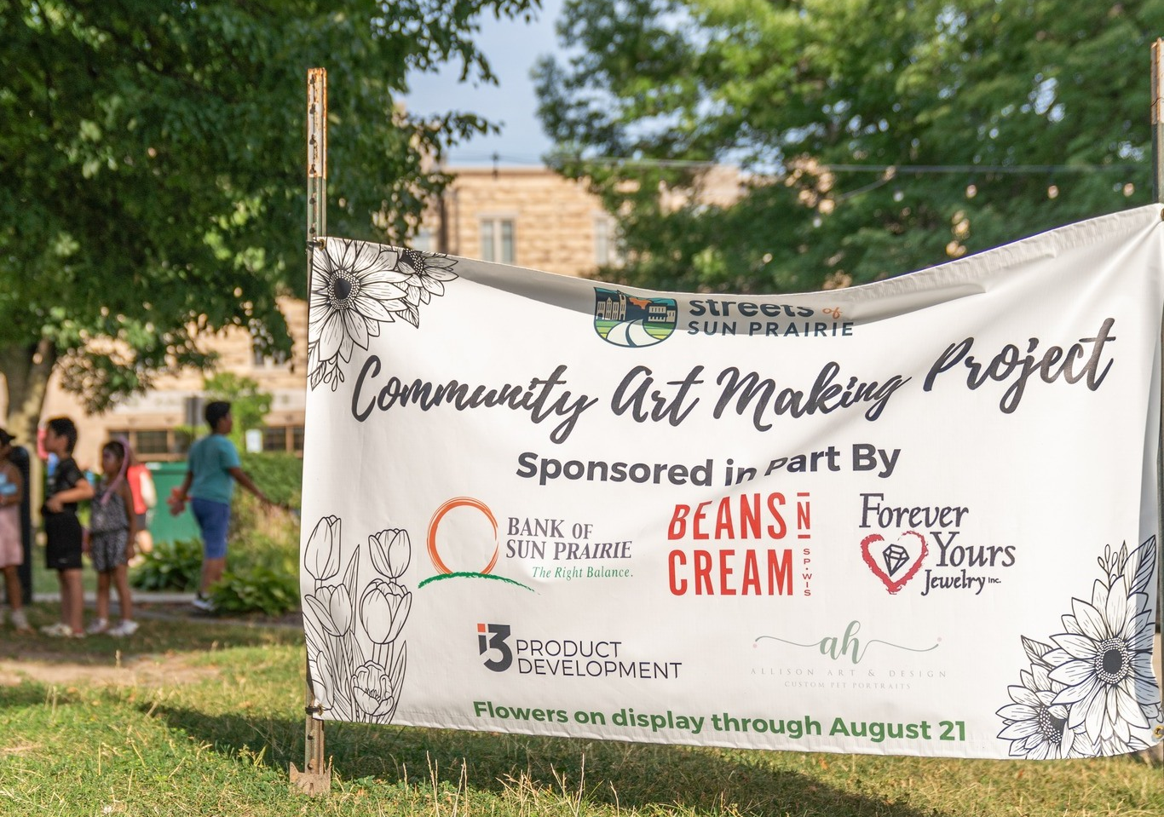
Downtown and Central Corridor
Vibrancy
Lokre Development – 92 dwelling units and approximately 12,000 sf of commercial/office space
Sun Prairie Utilities in the design process for their new facility located at 510 Linnerud Drive
The City of Sun Prairie is partnering with Saiki Design and MSA to design development efforts to enhance Cannery Square and facilitate pedestrian safety improvements downtown.
First year of Downtown Sun Prairie’s Downtown Community Art Making Project
Sun Prairie Farmers Market has been recognized as the leader in both the "Best Produce Selection" and "Best Area Event" categories.

Slide 8
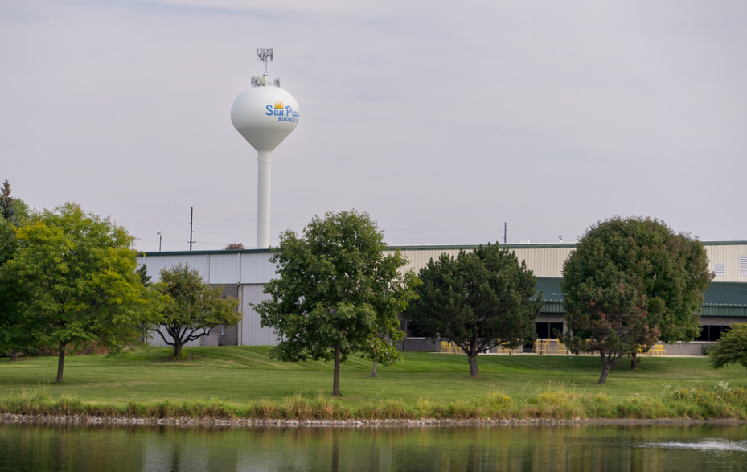

Dynamic Economy
City staff are currently updating the Economic Development Element of the Comprehensive Plan.
Sale and development of City-owned land in the Business Park.
Completion of the branding study and adoption of new brand. $50,000 in ARPA funding was allocated by the Council to support the brand implementation.
City recently awarded the Small Business Incubator Study and this assessment will begin in fall 2023.

Slide 9
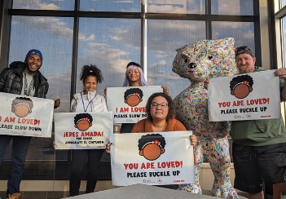
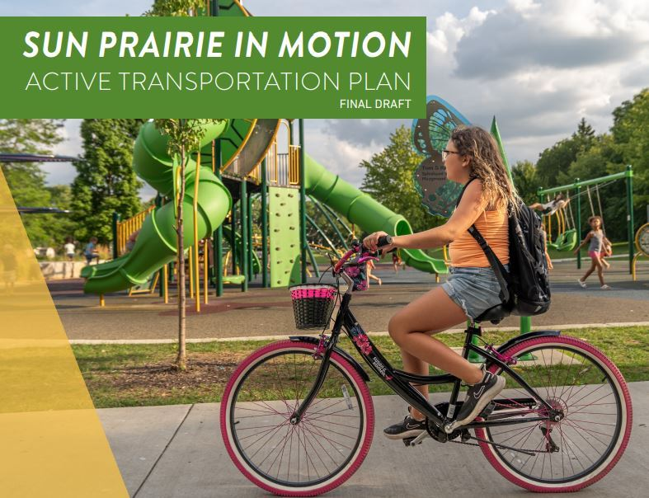
Complete Transportation Network
Madison Metro implemented local bus service starting June 11 – providing all day service 7 days a week.
  Park and Ride Enhancements in preparation for Bus Rapid Transit
Toole Design Group has completed work on the Active Transportation Plan which was adopted by Council in September of 2023.
Several WisDOT grants received for road projects including multi-use path expansion/reconstruction along N Bird Street (2024 and 2025).
Vision Zero Plan consultant to be selected later this year.

Slide 10
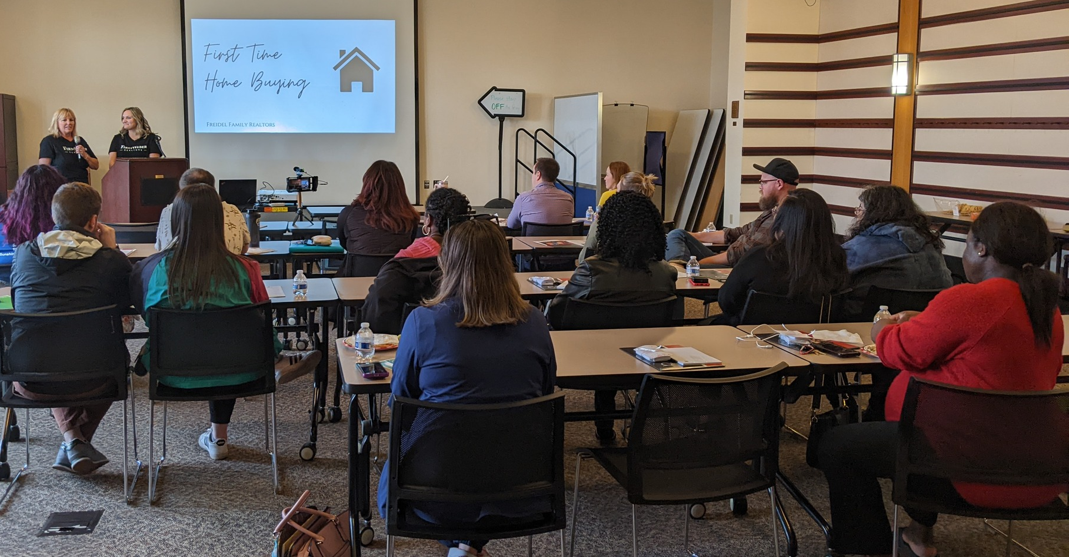

Human Services
2023 Budget included a recuring $10,000 to support staff time and resources needed for Sunshine Place to continue their efforts in coordinated emergency response and social service coordination for community needs.
Increased annual contributions to Colonial Club and Community Schools starting in 2023
Distribution of ARPA funding to community partners
Affordable Housing Programming in May in honor of Affordable Housing Month
Completion of WI DCF DreamUp! Grant and subsequent creation of supply-building grant program.
Participated in planning of first annual PrideFest

Slide 11

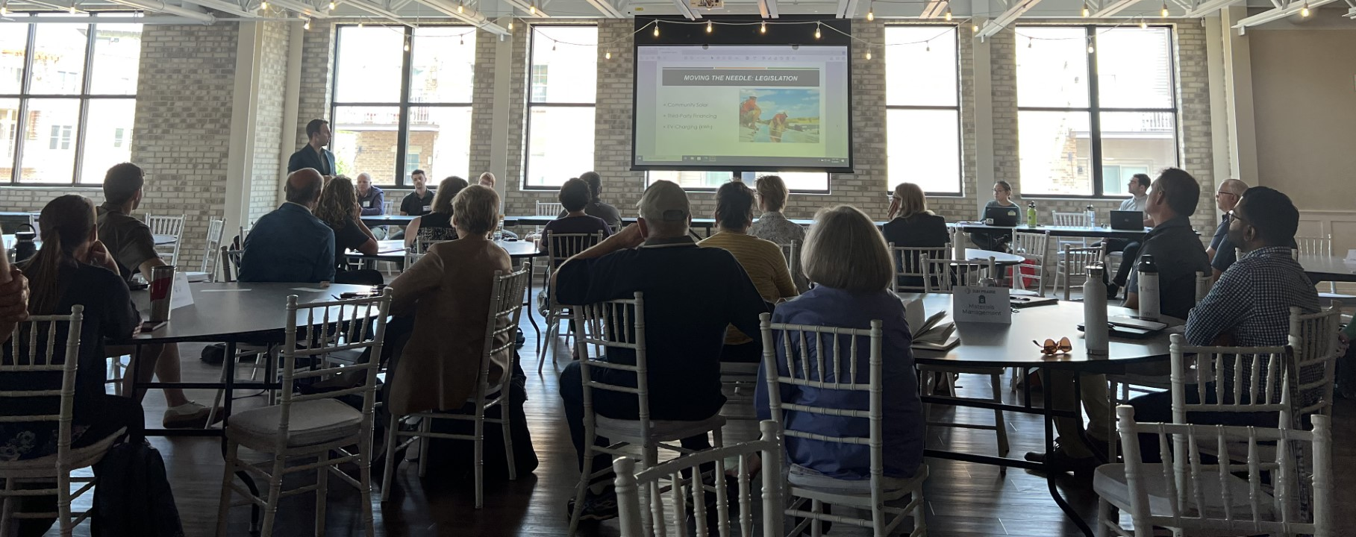
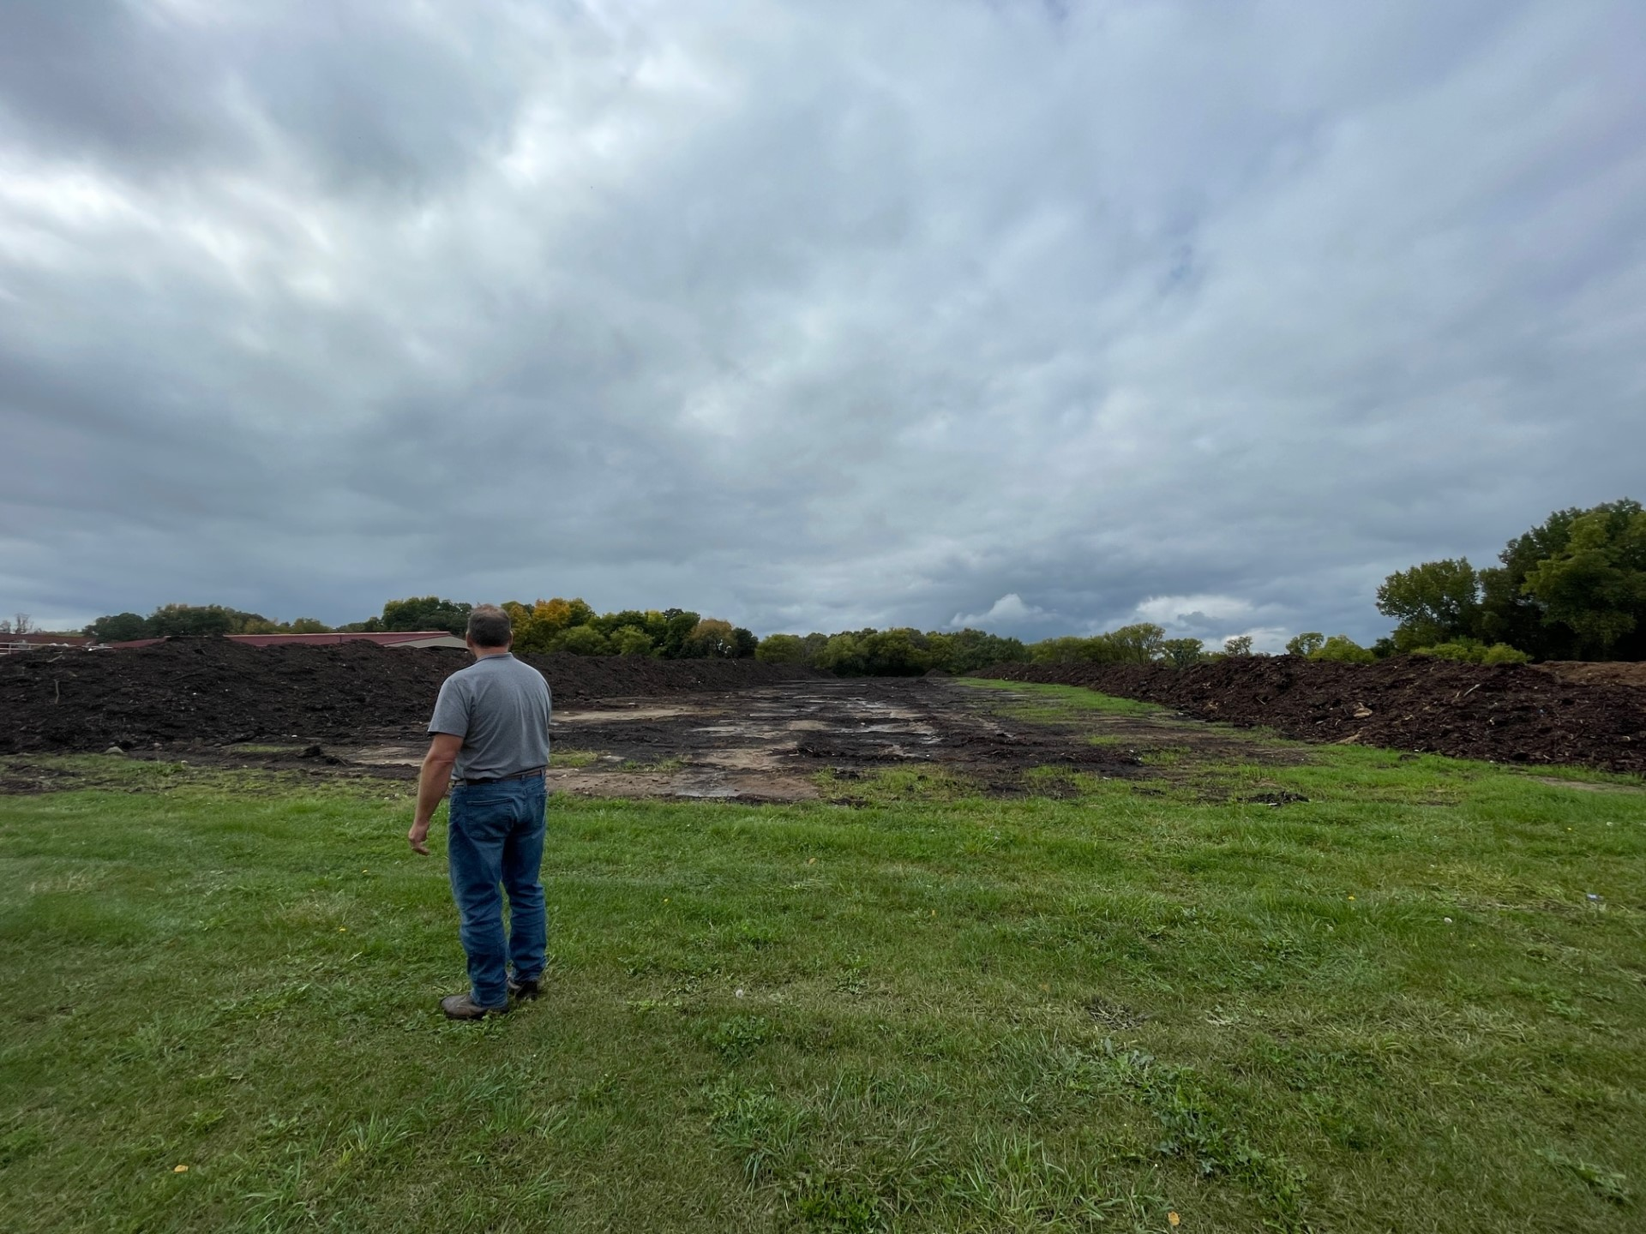

Sustainable Sun Prairie
Grant recipient of the Carbon Reduction Program for $120,000 in LED streetlight conversions.
Awarded Public Service Commission Office of Energy Innovation (OEI) 2022 Energy Innovation Grant Program (EIGP) grant of ~$748k for a multi-facility microgrid project (SPU building, Library expansion renovation) for additional Solar PV + Battery Energy Storage Systems (BESS).
Held first Sustainability Roundtable.
Annexation of Patrick Marsh into the city.
Created several pollinator gardens community wide including at City Hall.
Achieved Climate Champion status for the 3rd year in a row.
Weekly recycling Composting pilot of municipal yard waste.
Notes:
The grant significantly accelerate the city and utility efforts to convert municipal streetlight assets to LED. Currently $30,000 annually is budgeted for these conversions, resulting in an estimated turnover rate of 4% to LED annually. This project would essentially complete four years of those budgeted upgrades, saving the Sun Prairie community a significant amount of energy, resources, and provide a better lighting solution on roadways.
-Both facilities have strong sustainability goals; LEED Gold, net-zero all electric for SPU, ready for library
-Patrick marsh increases our parkland by 50%.

Slide 12
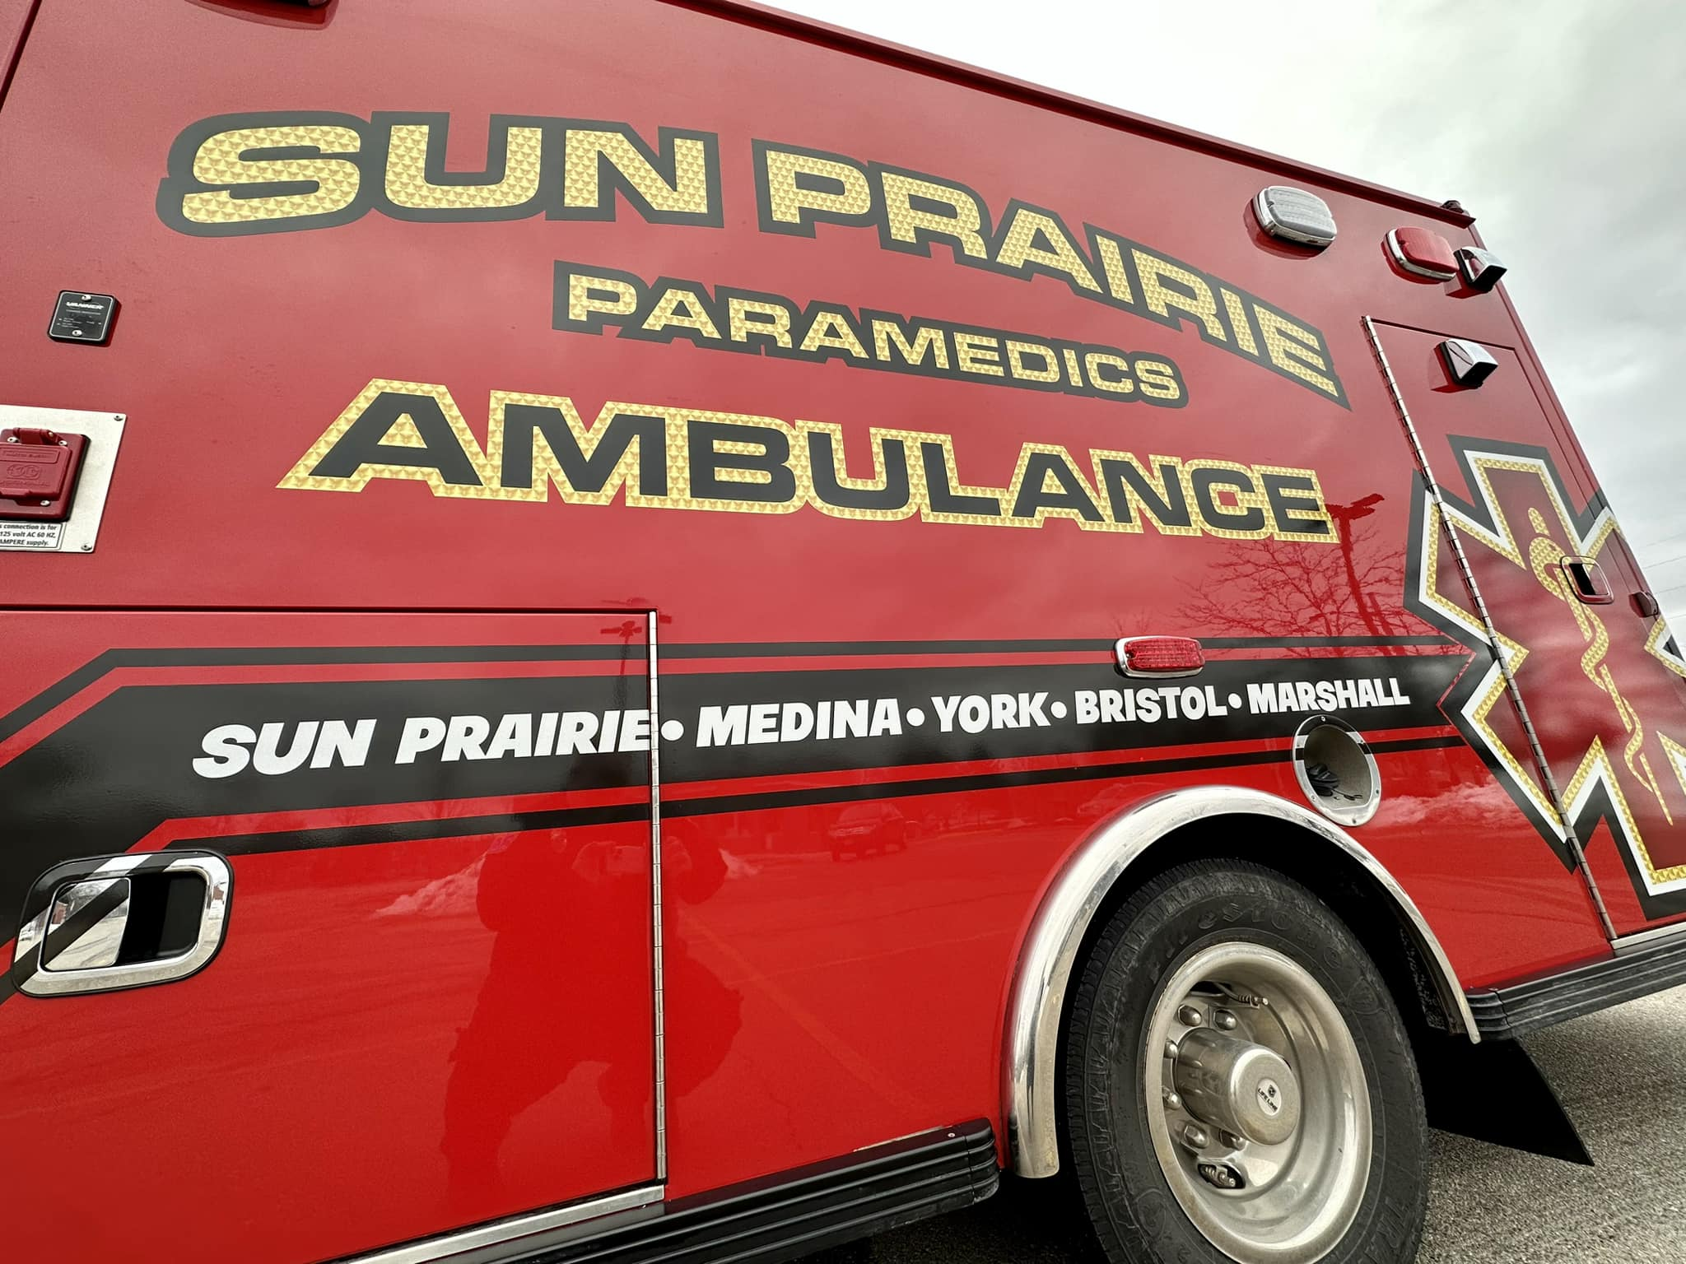
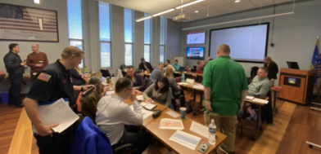

Quality City Services
Completion of the organizational equity audit
Fire & EMS Consolidation
Expansion of EMS service to Marshall
Full-time staffing of third ambulance
$3.2 million in federal funding to go toward solar radiation project at WWTP
Continued success in financial reporting with ACFR and PAFR
Emergency Management Functional Exercise Trainings
Library Expansion and Renovation
Notes:
-Community Development Department and GIS team for their hard work in creating a web application that allows folks to see current and planned development projects.
-This project will address the increase in wastewater received at the Wastewater Treatment Plant by utilizing solar radiation to reduce the volume of biosolids produced at the wastewater facility
-The trainings presented staff with a practice emergency situation and required a team to function as the Emergency Operations Center (EOC) and another as the Incident Command (IC). In addition to coordinating shelters, transportation, and other essential logistics, they also had to plan how they would communicate out to the public.

Slide 13
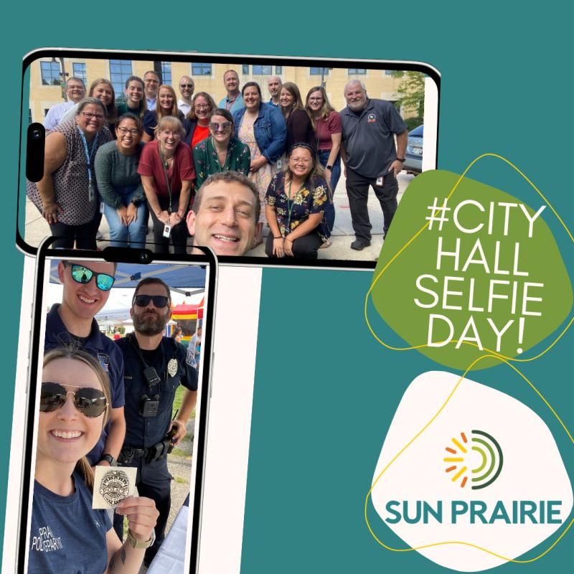
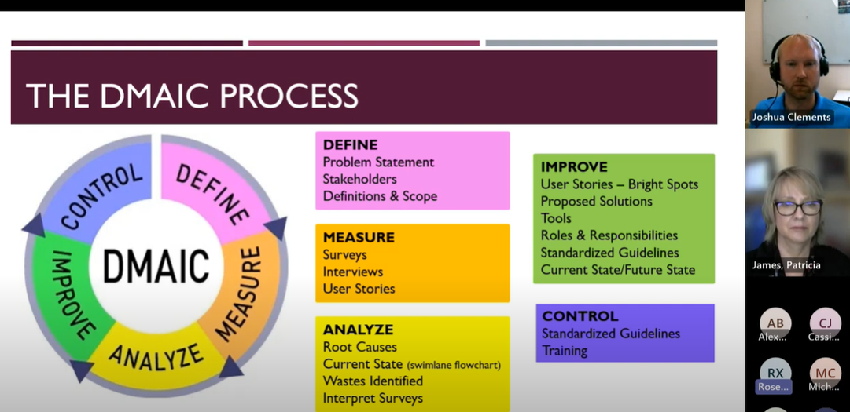
Employer of Choice
Completion and implementation of Non-Union Class & Compensation Study
2023 COVID Paid Leave
Addition of Behavioral/Mental Health Coach at the Employee Wellness Clinic
Continued professional development opportunities, Lean 6 Sigma, High Performance Organizational Training, Project Management training
Development of organizational mission, vision and values
Employee Experience Committee
Notes:
The City has a group of employees who meet regularly to plan and implement different activities for folks to get together, do something fun, and get to know one another!

Slide 14
Building on the Strategic Plan

Slide 15
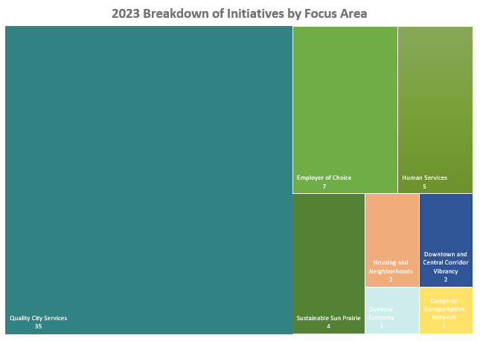
Operational Impact
2024-2033 CIP
2024 Budget
Financial Management Plan
  Levy limits
Notes:
-The anticipation of hitting levy limits will impact future initiatives included in the FMP

Slide 16
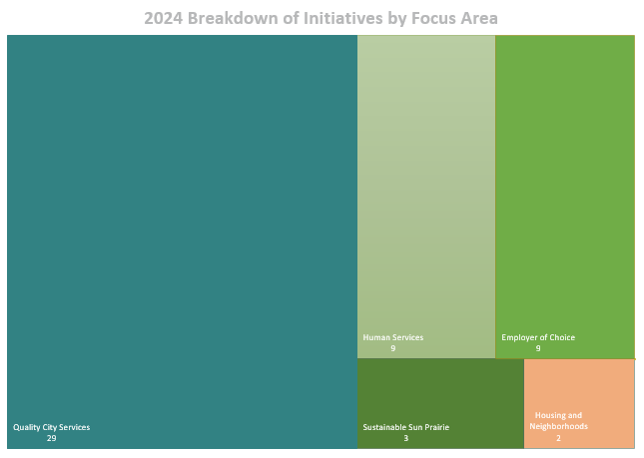
Operational Impact
2024-2033 CIP
2024 Budget
Financial Management Plan
  Levy limits
Notes:
-The anticipation of hitting levy limits will impact future initiatives included in the FMP

Slide 17
What’s Next?
Continued alignment of Budget and CIP process to the Strategic Plan
Strategic Plan Work Session in 2024
  Opportunity to review and revisit for alignment
  Reaffirm or add new priorities and focus areas

Slide 18
Thank you!

