Slide 1
Approval of Metro Transit Bus Routes & Paratransit Service for the City of Sun Prairie
Meeting of the Transit Commission
October 18, 2022

Slide 2
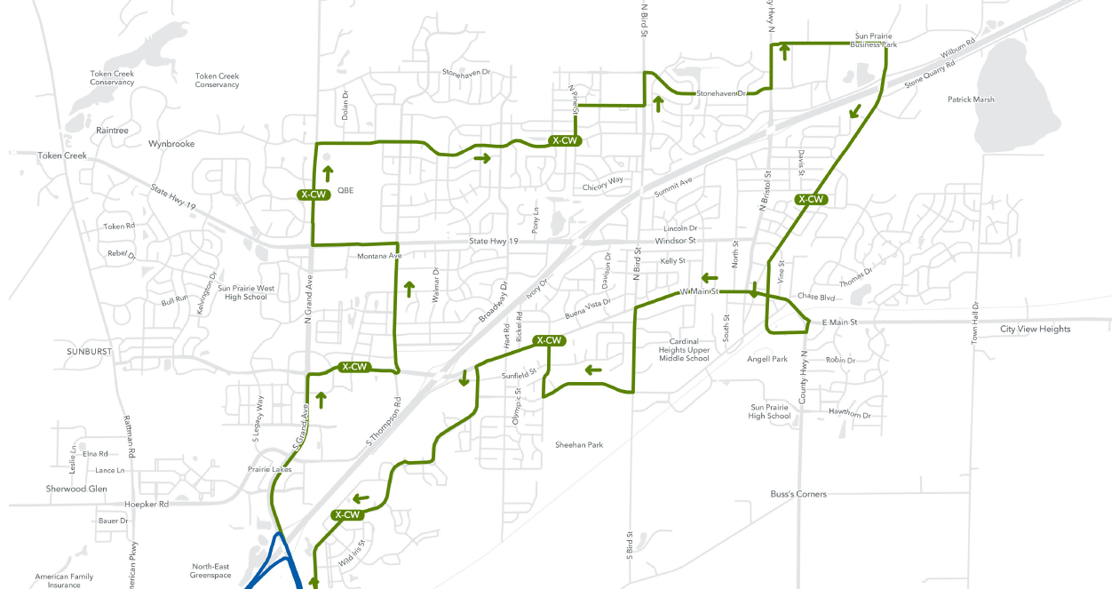
Consultant proposed route (JW + A)

Slide 3
Key takeaways from Survey Results
Areas most desired for Transit
By far the biggest: Access to Madison
Most interest is south of I-151
Areas less desired for Transit:
NW Sun Prairie, and the Business Park
General population is very supportive of local service
Most hesitation about a switch from SRT to Metro Transit expressed from Seniors

Slide 4
Key Takeaways from engagement: Pros
General consensus: “loop” style route is appropriate
Important destinations served: Woodmans. The Element/Sunshine Club. Dean Clinic. Downtown Sun Prairie. Park and Ride connection.
Two, 1-hr loops providing half-hour service is intuitive and popular
Lower fares are attractive
Pros, upon clarification
This route is part of greater BRT/Madison Metro network
Paratransit – the more knowledge of it, the more favorable an option it becomes

Slide 5
Key Takeaways from engagement: Cons/adjustments needed
General Consensus: Route is overall quite good, but some key adjustments are needed
Important: consistent themes as were expressed in Survey.
Destinations missed:
Windsor Street (esp. Schiller and Emerald/Ivory); Some concern over Sun Prairie west of Grand Avenue; more direct access to Colonial Club, other senior living
Primary concerns:
1) Transition for Seniors
2) Serving current shared-ride taxi base

Slide 6
Serving the needs of SRT riders AND Current Route 23 Riders
Route as presented in July addressed some issues, but still has logistical deficiencies that need to be ironed out:
Ridership
Very much catered to existing SRT base, but Route 23 ridership was left somewhat in the lurch.
Route 23 ridership is going through a significant increase
Connecting to the BRT: How buses will operate in Sun Prairie traffic is still unknown
Timing of route as presented in July is tight enough where bus could miss connecting with the BRT during rush hour
Metro requests more conservative timing: it is much easier to extend route later than to shrink it.

Slide 8
Two-Route Concept: Ridership AND Coverage
The modified proposal for local service achieves both improvements to ridership and coverage through splitting the one-loop, two-way route into two, one-way routes
Would utilize existing Shared-Ride Taxi Funding
Two-loops – one Clockwise, One Counterclockwise – running through the City
1 longer, clockwise loop: 7 days a week; Monday through Friday 5:00am – 11:00pm; Weekends 6:00am to 11:00pm
Prioritizes transit coverage, to match and improve
1 shorter, more frequent counterclockwise loop: Monday through Friday 6:00am – 6:00pm
Prioritizes growth in ridership observed with Route 23

Slide 9
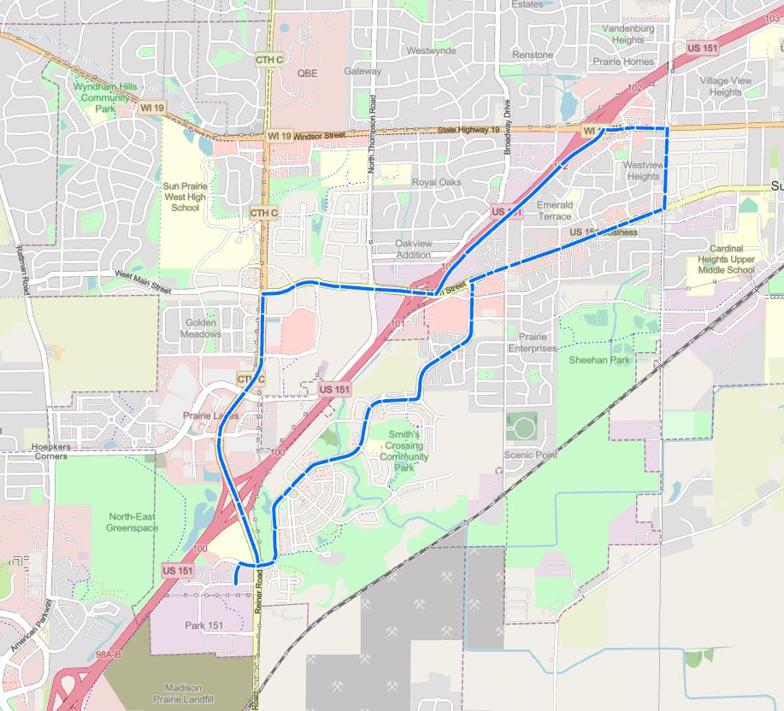
Route W: Ridership Route
M-F
6am – 6pm
Runs every half hour
Runs clockwise
Has three primary benefits
1) serves current and future Route 23 users
2) half-hour service lends itself to higher ridership utilization
3) largest clusters of SRT ridership all receive dramatically higher levels of service
Pending Route Finalization

Slide 10
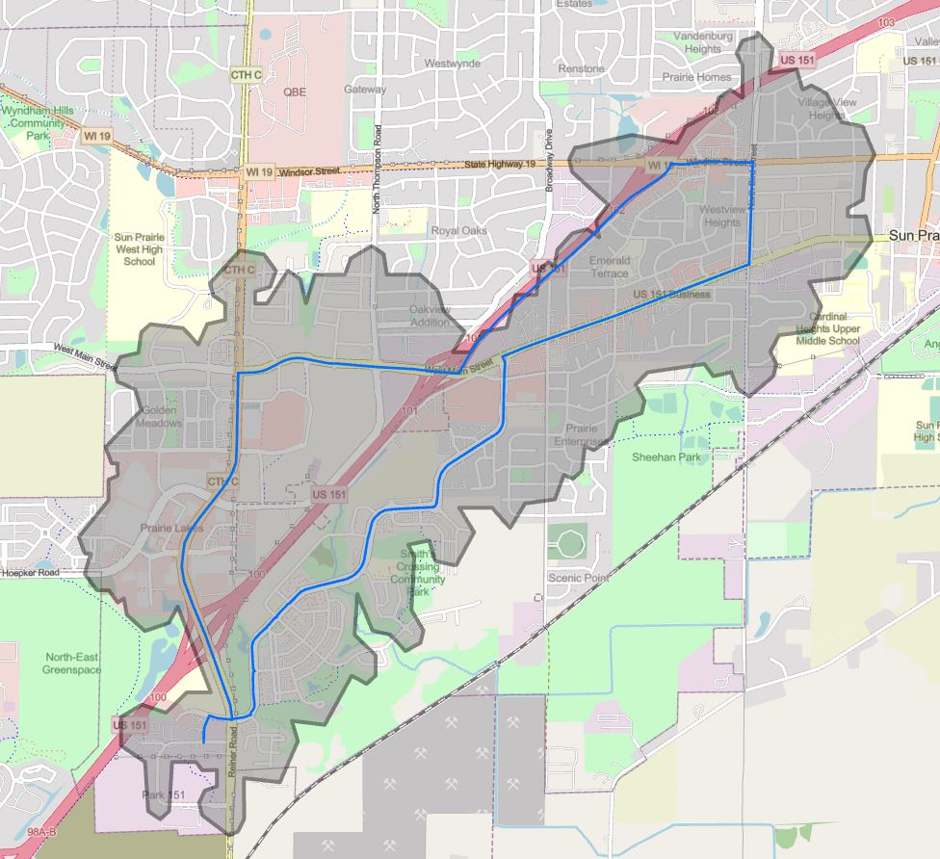
Route W - ½ mile Walk
Pending Route Finalization

Slide 11
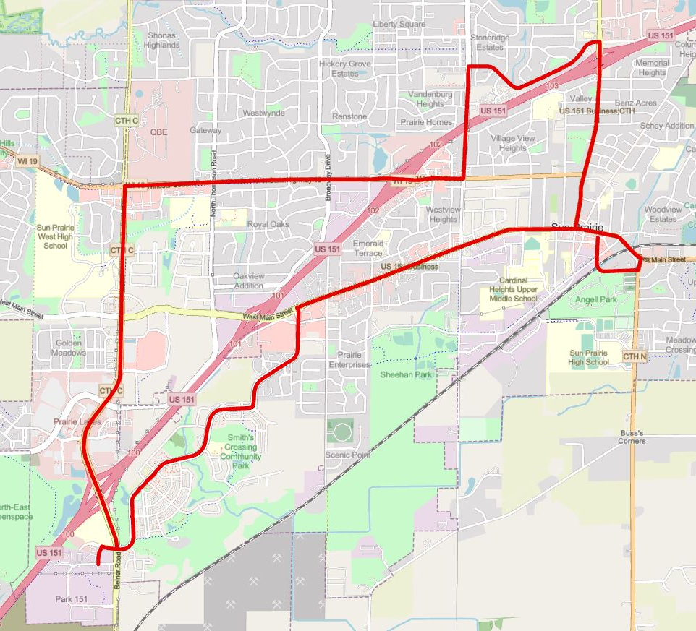
Route S: Coverage Route
7 days week
5am – 11pm M-F
6am – 11pm Weekends
Runs every hour
Runs Counterclockwise
Has three primary benefits
1) serves current and future SRT users, and generally improves reliability of service
2) Maximizes the paratransit service area
3) Coverage reflects and prioritizes findings from the 2021 Survey.
Pending Route Finalization

Slide 12
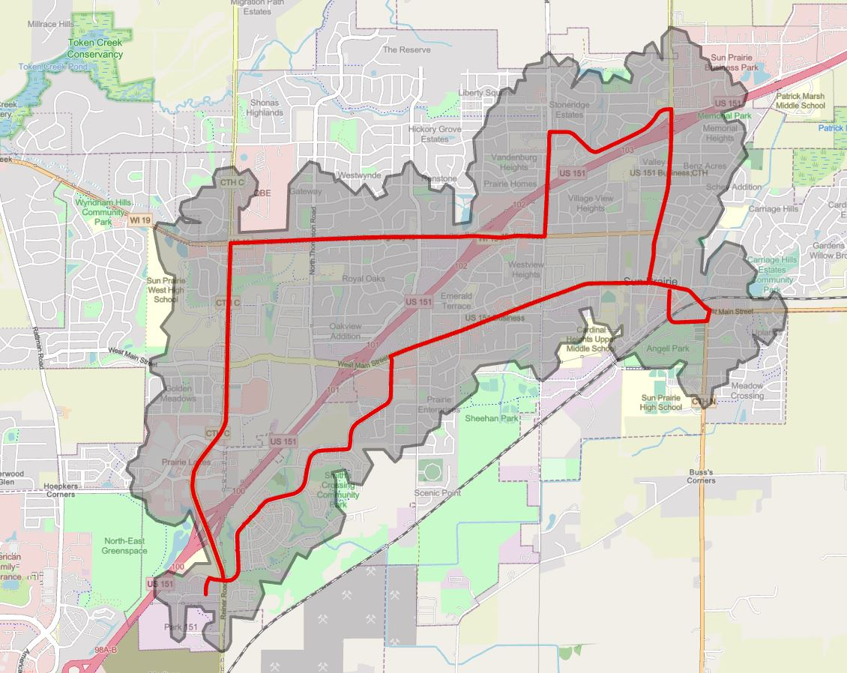
Route S - ½ mile Walk
Pending Route Finalization

Slide 13
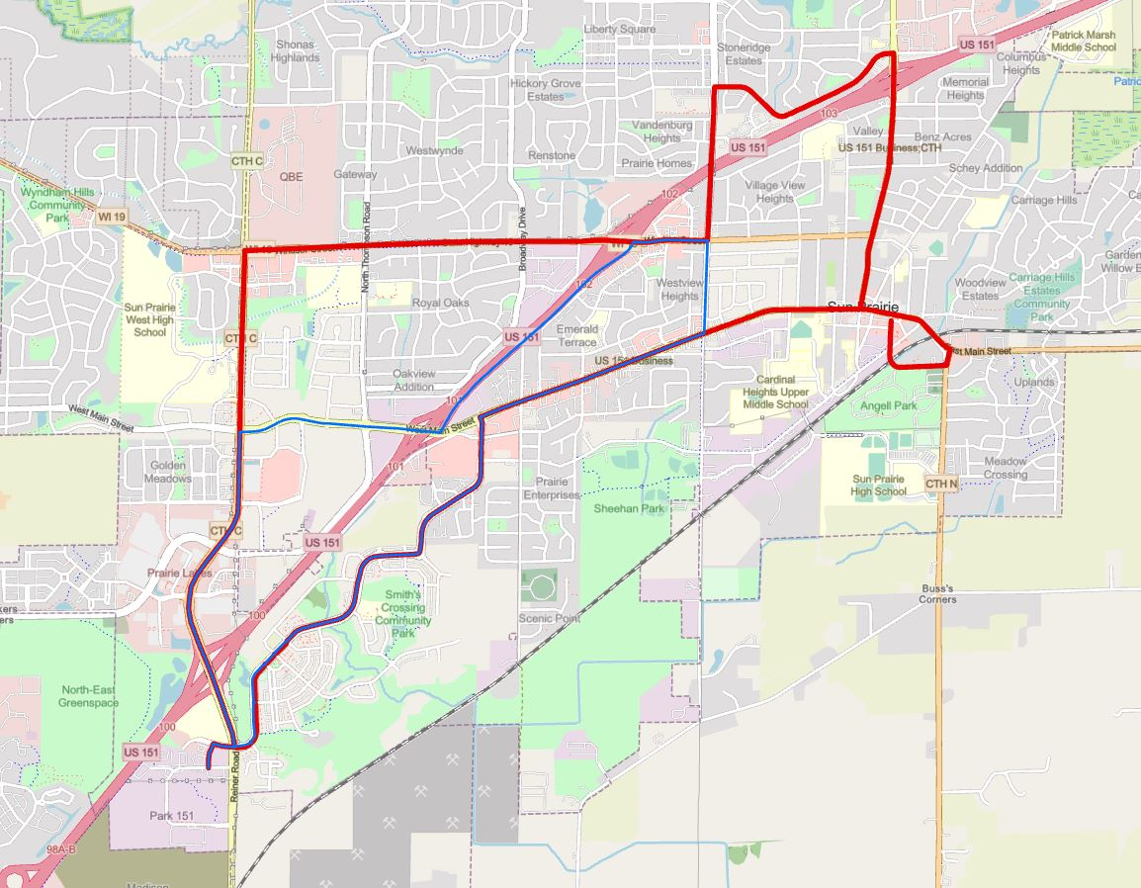
Routes S & W
Schiller/Emerald
W Main/S Bird/The Element
Prairie Lakes
These areas would get a bus 3x an hour from 6-6 on weekdays
Smith’s Crossing
Pending Route Finalization

Slide 14
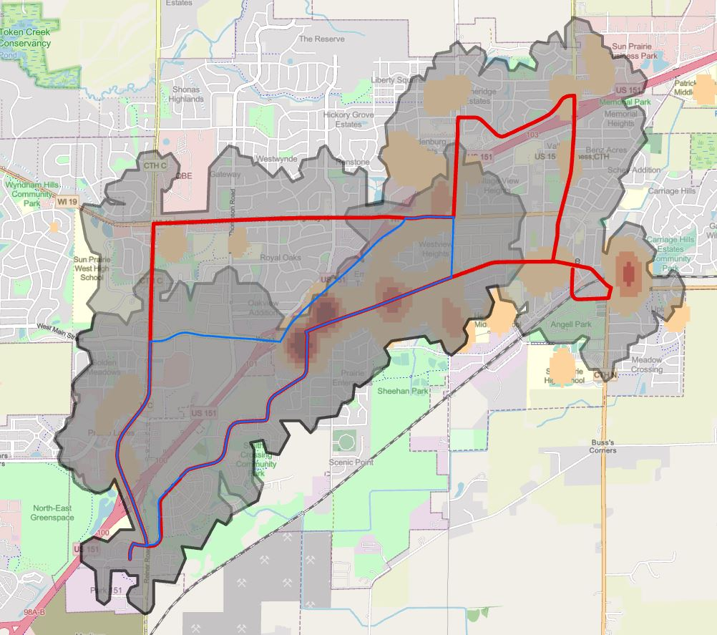
Routes S & W, and SRT Ridership
Pending Route Finalization

Slide 15
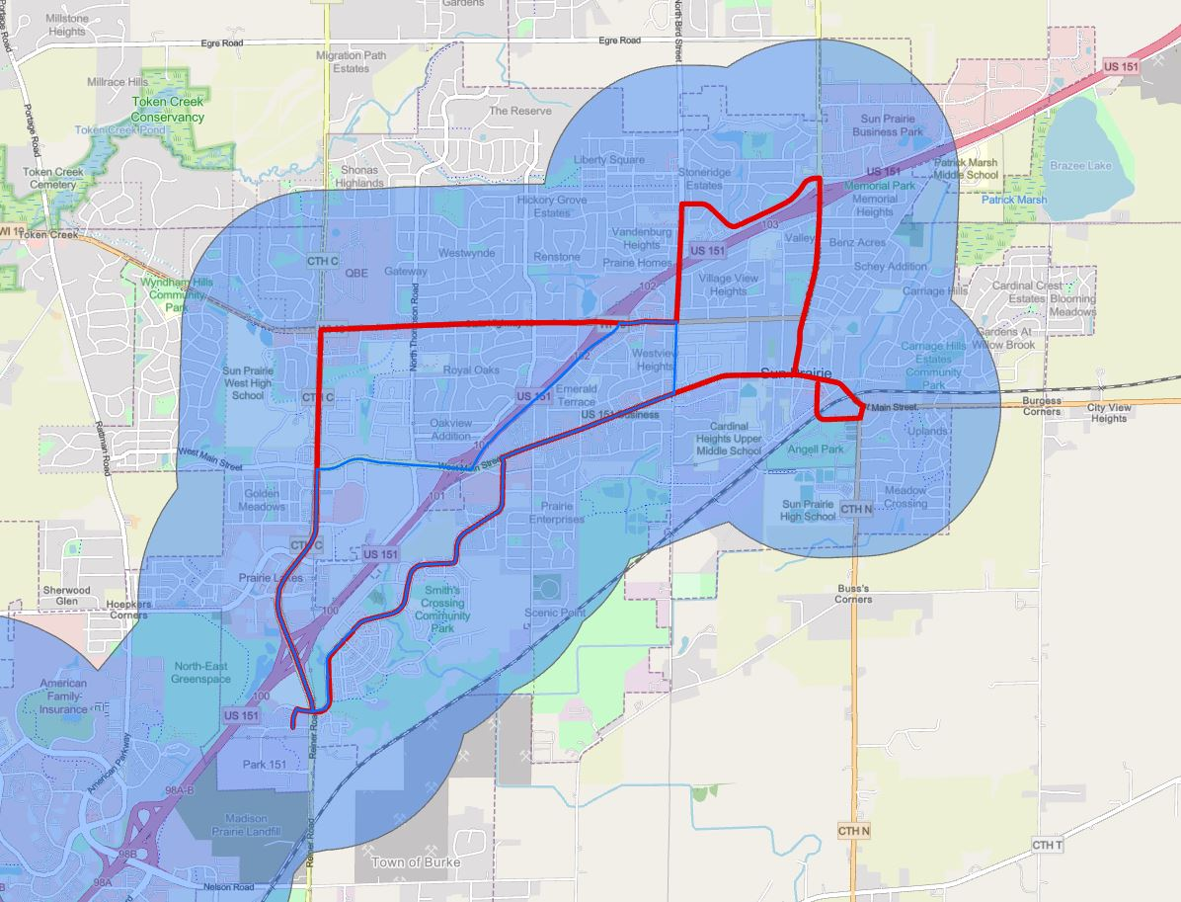
Para-Transit Service Area (in Sun Prairie)
Pending Route Finalization

Slide 16
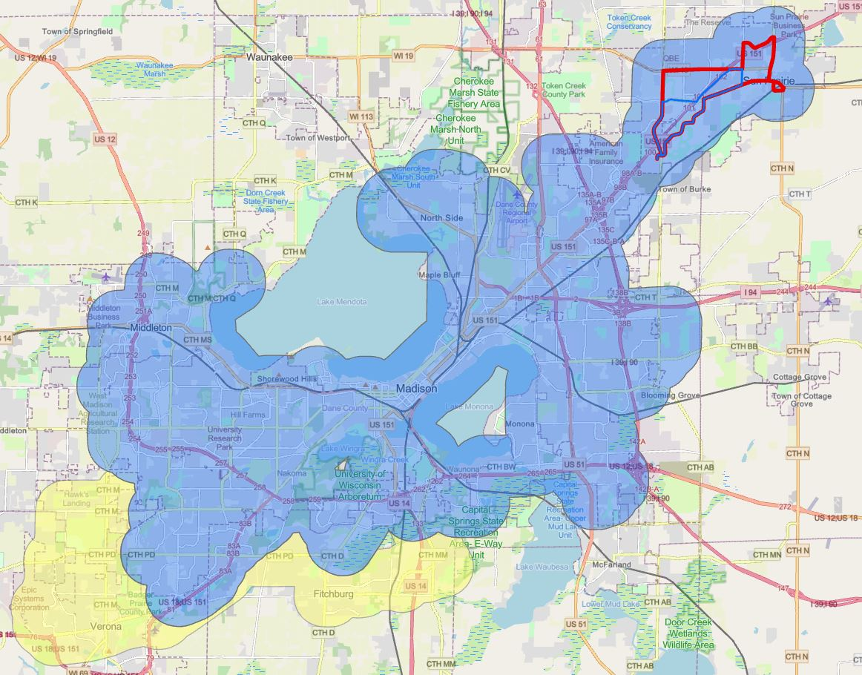
Para-Transit Service Area (Madison Area)
Pending Route Finalization

Slide 17
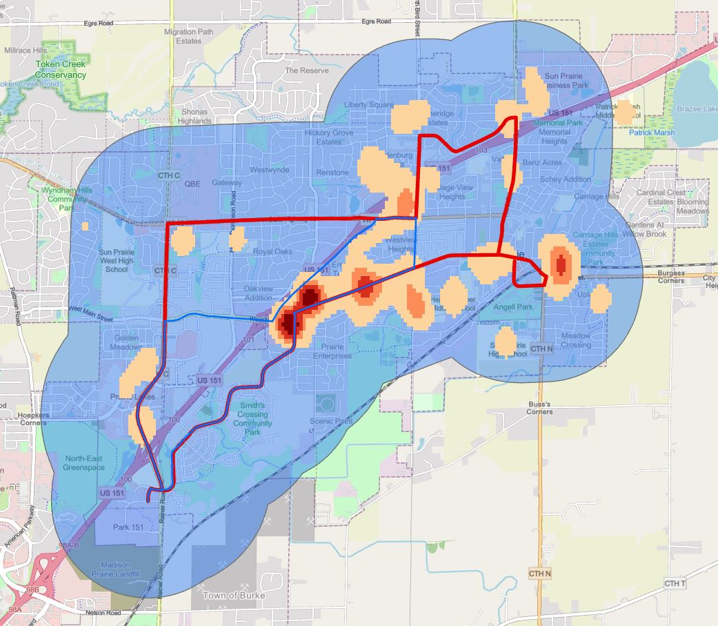
Paratransit Area & SRT Ridership
Pending Route Finalization

Slide 18
Improvements in Service to Following Locations compared to JWA Route
Vandenburg Heights
McKenzie Boys & Girls Club
N Grand Avenue Corridor
Sun Prairie West High School
Windsor Street Corridor/HWY 19
Schiller Street/Emerald Terrace
The Element
West Main Street

Slide 19
Reductions in Service to Following Locations compared to JWA Route
Sun Prairie Business Park
St Albert the Great Drive Corridor
Linnerud Drive Corridor
Columbus Street Corridor
Liberty Square

Slide 20
Same level of Service as JWA Route
Prairie Lakes Shopping Centre
Downtown Sun Prairie
Smith’s Crossing/O’Keeffe Avenue
West Main Street Corridor
Smith’s Crossing/O’Keeffe Avenue
S Bird Street Housing
Sun Prairie Public Library

Slide 21
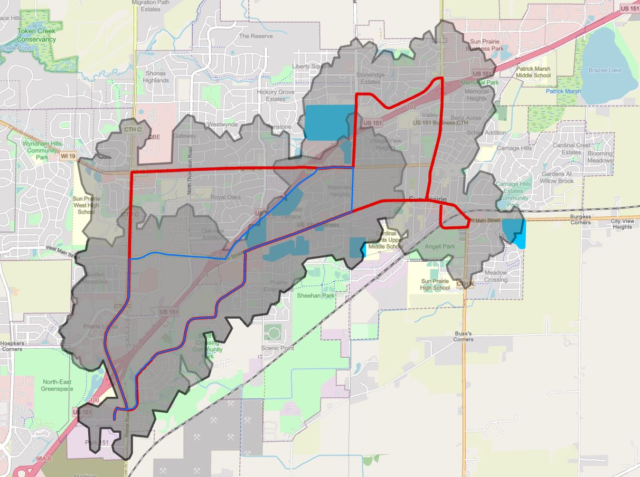
Low-Income Areas
Vandenburg Heights
Crosstown/Schiller St
Ivory Dr
Element
The Uplands
Sunny Hill/ Rolling Prairie
Pending Route Finalization

Slide 22
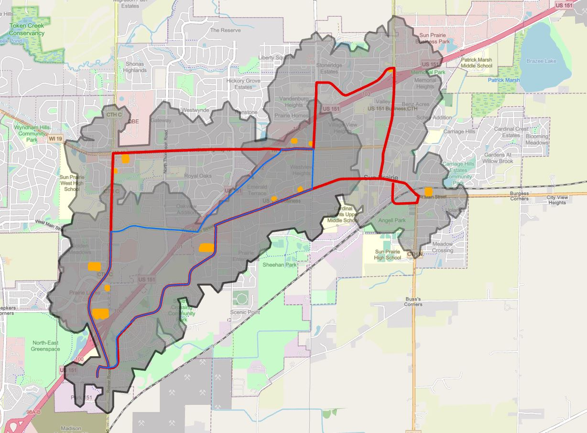
Grocers
Metro Market
Pick’n’Save
Target
Wal-Mart
Woodmans
Pending Route Finalization

Slide 23
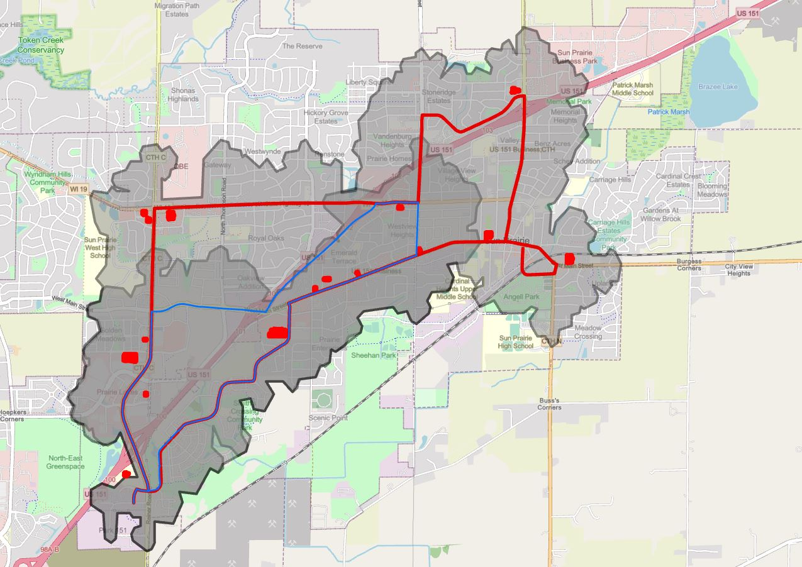
Medical & Pharmacies
Dean Clinic
UW Health
Health Care Center
FirstCare/ Crossroads
Pending Route Finalization

Slide 24
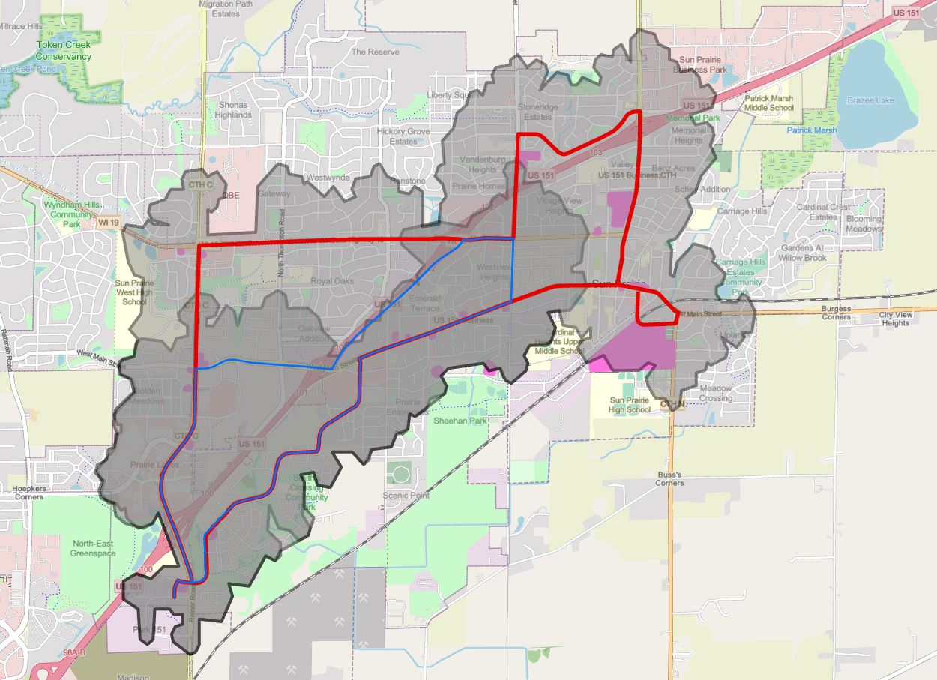
Community Facilities, Banks, Major Parks
PAC
Boys & Girls Club
City Hall
Sunshine Place
WestSide Center
Library
YMCA
Pending Route Finalization

Slide 25

Multi-Family Housing
Pending Route Finalization

Slide 26
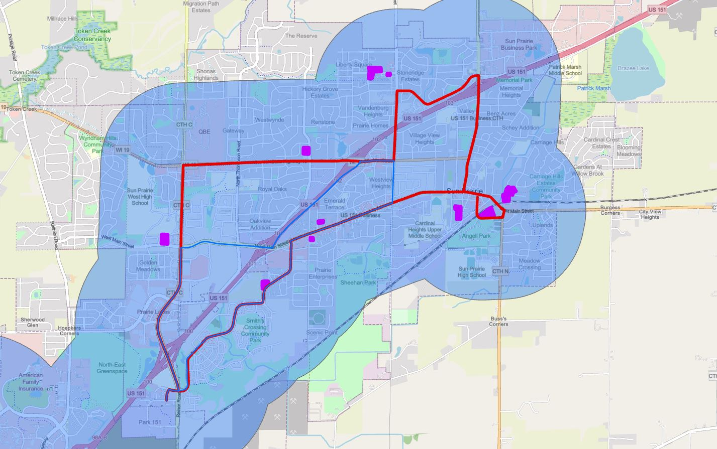
Senior Housing
Hyland Park & Liberty Square
Colonial Club and TallGrass
Angell Park and New Perspective
Pending Route Finalization

Slide 27
Infrastructure Needs
Bus Stops
Signs and ADA-compliant concrete boarding pads
$250K in CIP in 2023 for this
Likely about 38 additional stops, assuming roughly quarter-mile spacing between stops (estimate)
This route configuration is somewhat LESS infrastructure intensive as previous concepts
Traffic Control
A few possible intersection control changes to allow buses to make turns
Tower Drive may need to be further evaluated to make sure bus can get through (on-street parking)
Likely removal of Tower Drive pedestrian refuge island to allow for turning movement

Slide 28
Next Steps
Engage
Plan approval by Madison & Sun Prairie
MOU between Madison and Sun Prairie, budget already accounts for these routes
Engagement will continue (information purposes, continued dialogue with schools and senior living facilities)
Build
Early 2023: Bus Stops
Determine location, construct pads and signs (possibly shelters)
Launch
Mid-to-Late 2023*: Route Implementation
“Soft Launch” soon as Summer 2023
Route 23 dollars go toward BRT, and SRT dollars go toward Routes S and W
BRT
2024: Formal Bus Rapid Transit launch in Autumn 2024
November/December action by Council
Work extensively with Metro Transit & Dane County Transportation to facilitate smooth transition for future paratransit users.

Slide 29

Local Transit Service Planning Process (2022)
March
Disseminate Survey, Evaluate potential route
Mar.–June
Determine options for incorporating service, Stakeholder engagement
Other key questions: What does state/federal aid look like? How much more can city invest? Is there a role for shared-ride taxi in the future?
June–Aug.
Public Engagement
Present option(s) to public
Aug.–Oct.
Selection of Route(s)
Engagement on Paratransit
Nov.–Dec.
Approval by City Council
Timeline to accommodate POTENTIAL Fall 2023 Start Date

Slide 30
Local Transit Service Planning Process (2023)
Jan-Aug
Install Bus Stop Infrastructure
Educate the public on changes to Transit in Sun Prairie, esp. on Paratransit Usage
Summer/Autumn 2023
Local bus service across Sun Prairie and to Madison begins
Timeline to accommodate POTENTIAL Fall 2023 Start Date

